Slide 1
European Digital Innovation Hubs Network
Driving the EU’s digital transformation

Slide 2

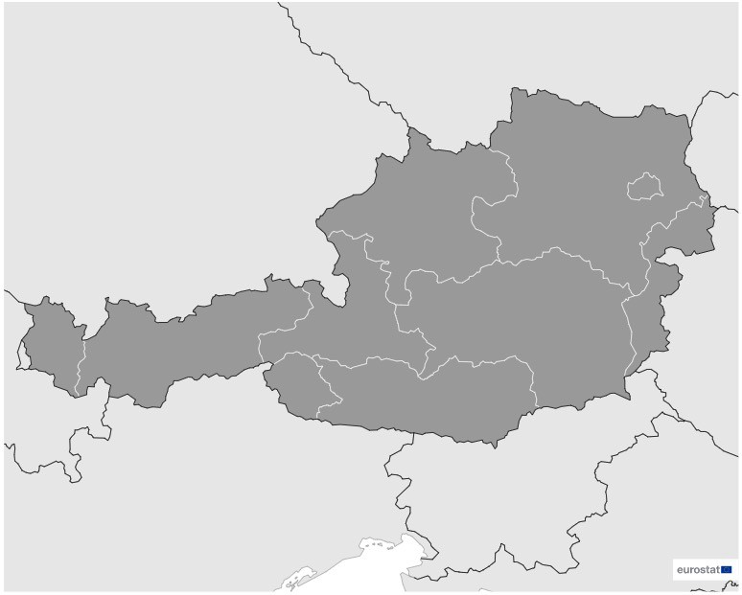
Austria
EDIH
4
Members
4/4 *EDIHs
1
3
2
13
Sectors
EDIHs in Austria
4
Austrian EDIHs are at the forefront of digital innovation in key sectors, including manufacturing, travel and tourism, and community-led local development.
Playing a fundamental role in helping businesses in their path to digitalisation, these EDIHs have the resources, capabilities, and experience to serve small and medium-sized companies operating in several industries.
Each Austrian EDIH is specialised in different sectors. Their focus is mainly on manufacturing and processing, construction, automotive, energy, food, paper and wood, travel and tourism.
*European Digital Innovation Hubs
*Funded under Digital Europe Programme

Slide 3


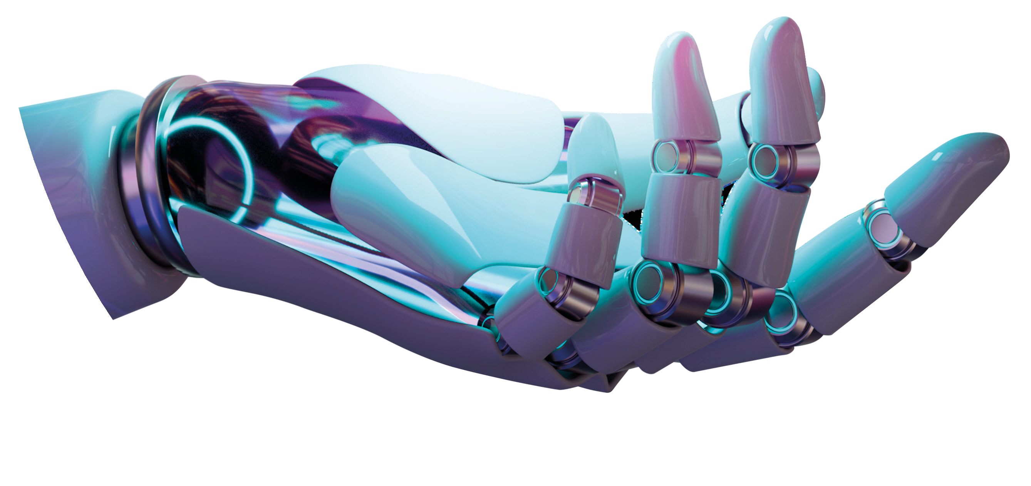
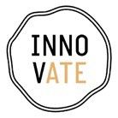
Network overview: 4 members – 4 EDIHs
AI5production
Applied CPS
Crowd in Motion
EDIH innovATE

Slide 4








Services
17 Technologies
Austrian EDIHs excel in leading technologies, such as artificial intelligence and decision support, big data, and the internet of things.
Field trials, prototyping, and finance stand out as key services provided by Austrian EDIHs, offering businesses practical testing, innovation development, and financial support.
The country’s technological landscape has the potential to go even further with the support of EDIHs in advancing robotics, cyber-physical systems, semiconductors, and nanotechnology, as well as simulation engineering and modelling.
The services supplied also involve ecosystem building, innovation management, and SME support, encouraging information sharing and collaboration to enable companies to thrive in the digital economy.
Besides technological innovation and knowledge transfer, circular economy services stand out from the offerings of Austrian EDIHs, preparing businesses for current and future challenges of the market.
Committed to secure digital environments, the hubs are dedicated to cybersecurity, blockchain, and distributed ledger technology (DLT).
https://european-digital-innovation-hubs.ec.europa.eu/home

Slide 5







Success stories
Rising above challenges: Brotsüchtig GmbH’s supply chain optimisation
Service type
Challenges
EDIH
Test before invest
Brotsüchtig GmbH, a local bakery with four stores, faces challenges with its manual production planning process, which relies on cluttered and complex sales data from individual POS systems. The goal is to streamline and expedite this process by preparing and visualising data more efficiently.
CUSTOMER
Brotsüchtig GmbH
Website
Small-sized enterprise with 10-49 employees.
Technologies
Data
Solutions
Optimisation of production planning, using a Power BI report to analyse POS sales;
Incorporation of external data, such as holidays and weather forecasts, identified as key factors;
Development of a unified dashboard, allowing detailed sales analysis across all stores, with filters for product and date;
Improvement of production planning accuracy and operational efficiency.
Sectors
Food and beverages

Slide 6



Success stories
Rising above challenges: Brotsüchtig GmbH’s supply chain optimisation
Thanks to EDIH AI5production the SME achieved::
Results and benefits
Enhanced digital transformation and planning efficiency
Customers' understanding of potential improvements through digital transformation has significantly increased. Detailed information required for planning is now easier to navigate and comprehend. The new user-friendly report allows personnel who previously struggled with the POS system to participate in production planning.
Improved production planning accessibility
The new user-friendly report enables personnel who previously struggled with the POS system to now participate in production planning.
Reduction of waste
There is a notable reduction in unsold baked goods and waste of raw materials. Bakers' work time has decreased due to more accurate production estimates, preventing overproduction.
pioneering digitalisation project: represents an innovative digital transformation for the traditionally non-digital bakery industry;
systematic data processing: integrates distributed data and various influencing factors for added value;
resource and waste reduction: focuses on careful resource use and significant waste reduction;
predictive planning: enhances accuracy in predicting customer purchasing behaviour for better planning;
energy conservation: conserves energy resources and reduces food waste;
eliminates equalisation trips: reduces the need for daily trips to manage oversupply and shortages;
sustainability: paves the way for continued advancements and sustainability in the bakery industry.
Lessons learnt
Prototyping an initial concept for an uncertain customer effectively fosters discussions and generates new ideas, bridging the gap between abstract concepts and tangible outcomes.
Allowing customers to interact with an early product version provides hands-on experience and establishes feedback loops, clarifying their needs and ensuring the final product aligns with their expectations and requirements.

Slide 7

Good practices
Accelerate your start-up through the TECHHOUSE ELEVATOR Programme
EDIH
Challenges
Solutions
The main challenge faced by the TECHHOUSE ELEVATOR Programme was addressing the lack of digital innovation expertise among start-ups and SMEs in central and eastern Europe. These companies struggled to scale their businesses due to limited access to technological tools and cross-border partnerships, which are essential for fostering innovation. Additionally, their ability to integrate advanced technologies, such as AI and sustainable solutions, into their processes was hindered by these gaps, creating a need for targeted support to boost their digital and business capabilities.
Workshops and training: provided workshops focusing on essential areas such as business modelling, branding, and sales strategies;
Tailored coaching: delivered personalised coaching sessions to address specific needs of each start-up, enabling them to refine their strategies and technological integration;
Networking opportunities: connected participants with the Austrian innovation ecosystem, encouraging cross-border collaborations;
AI integration: supported the integration of AI into production processes, fostering efficiency and innovation.
Services
Networking and access to innovation ecosystems, support to find investment, training and skills development
Technologies
Communication network
Sectors
Agricultural biotechnology and food biotechnology, food and beverages, energy, and paper and wood

Slide 8
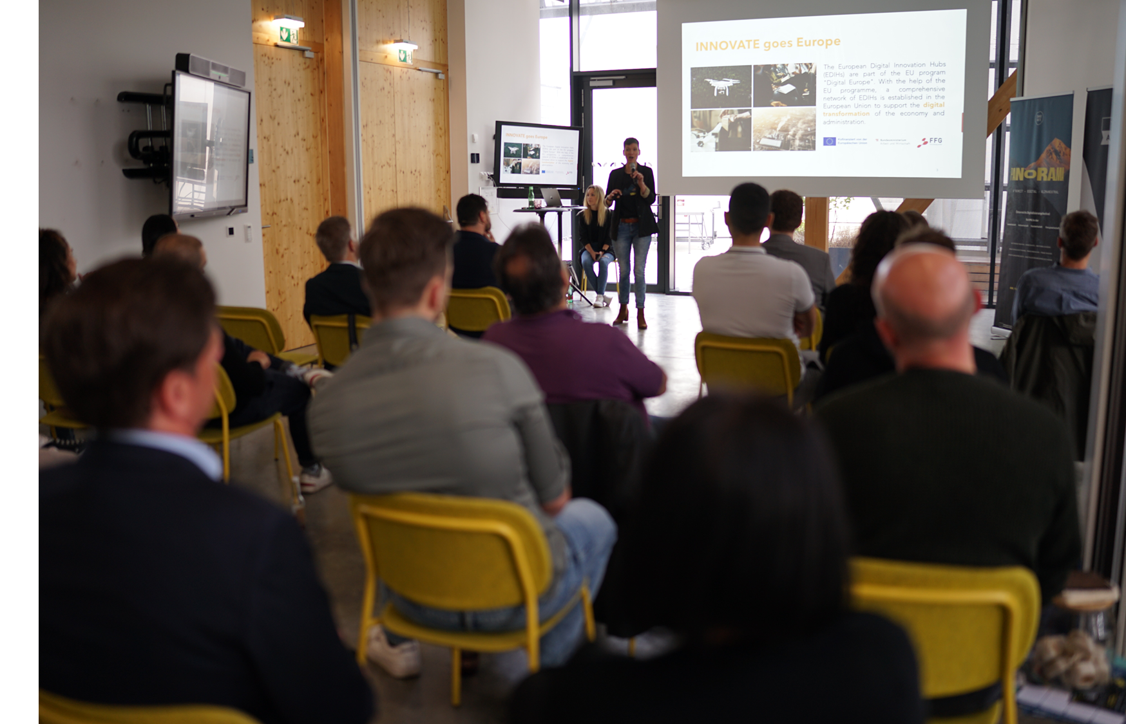

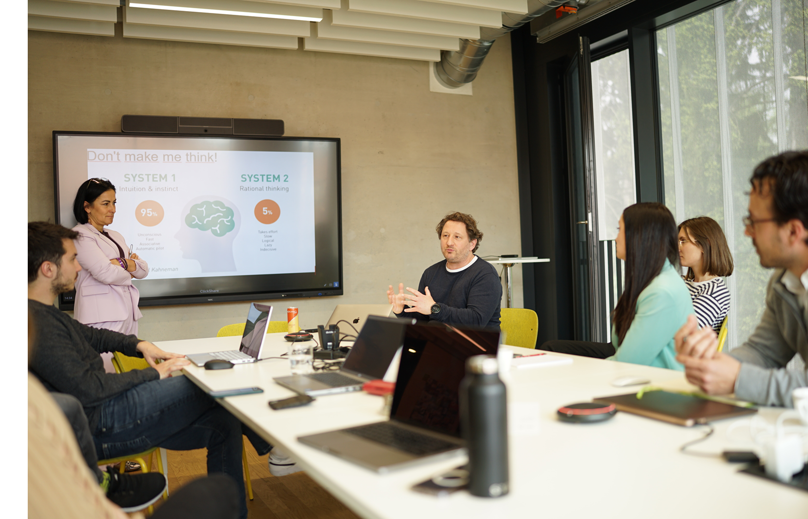

Good practices
Accelerate your start-up through the TECHHOUSE ELEVATOR Programme
Lessons learnt
Results and benefits
Cross-border partnerships
The programme facilitated collaborative innovation by connecting start-ups and SMEs across borders, enhancing their access to international resources and expertise.
AI integration in production
Start-ups successfully integrated AI into their production processes, improving operational efficiency and creating more competitive products.
Enhanced digital maturity
Several participating businesses significantly improved their digital maturity, showing a marked enhancement in their technological capabilities and readiness for future challenges.
Tailoring coaching to meet specific start-up needs significantly boosts their innovation capacity;
Introducing start-ups to local and cross-border ecosystems accelerates their growth and development;
Fostering a collaborative environment supports the sharing of knowledge and resources across regions.
Participating companies showed digital maturity increases, ranging from 13% to 49%, reflecting the programme's impact on improving their technological capabilities.
Images from the three-module TECHHOUSE ELEVATOR Programme

