Slide 1
European Digital Innovation Hubs Network
Driving the EU’s digital transformation

Slide 2
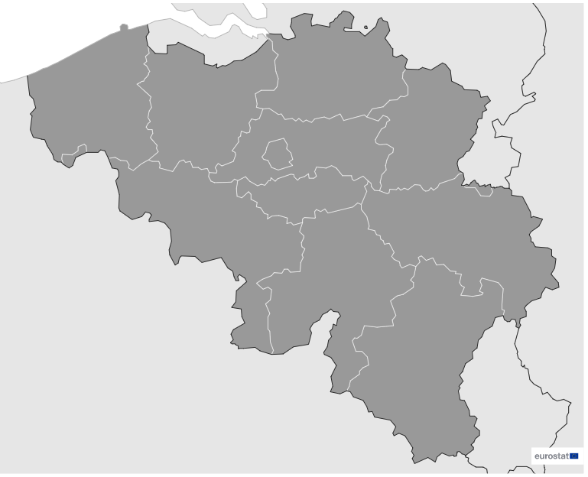

Belgium
EDIH
5
6
Members
6
6/6 *EDIHs
1
3
4
2
3
22
Sectors
EDIHs in Belgium
Drive innovation in manufacturing, using digital technologies to enhance efficiency and technological advancements.
Collaborate with stakeholders in the energy sector to implement cutting-edge technologies, fostering innovation and sustainability.
Support growth in the construction and assembly sector, promoting advanced technologies for sustainable infrastructure projects nationwide.
*European Digital Innovation Hubs
*Funded under Digital Europe Programme

Slide 3






Network overview: 6 members – 6 EDIHs
DIGITALIS
EDIH-CONNECT
EDIH-EBE
Flanders AI EDIH
sustAIn.brussels
WalHub

Slide 4








Services
24 Technologies
Leverage artificial intelligence and decision support, big data, and digital twins to conduct innovative data analytics and simulation techniques across various industries.
Excel in technological innovation, offering advanced solutions for diverse industries.
Emphasis placed on high-performance computing, IoT, and robotics, driving intelligent solutions in manufacturing, logistics, and human-computer interaction.
Play a key role in innovation through prototyping and technology transfer, translating research into practical applications.
Prioritise cybersecurity, virtual reality, and additive manufacturing, ensuring the security of digital ecosystems while pioneering immersive experiences and innovative production processes.
Prioritise ecosystem building, SME support, and financial services, fostering innovation ecosystems, aiding small enterprises, and providing financial support for projects.
https://european-digital-innovation-hubs.ec.europa.eu/home

Slide 5


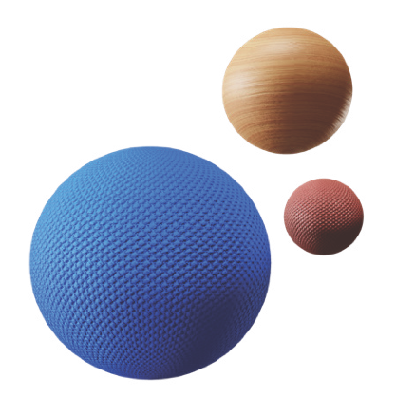




Success stories
Smart packaging: evaluating the feasibility of tomorrow’s solutions
Service type
Challenges
EDIH
Test before invest
Conforma faced challenges with manual packaging processes for small-batch, varied products, which hindered efficiency and growth. Traditional automated packaging machines were unsuitable due to the diversity and small scale of production, prompting the need for a flexible and scalable solution to handle product variety while maintaining efficiency.
CUSTOMER
Conforma
Website
Medium-sized enterprise with 50-249 employees.
Technologies
Robotics
Solutions
Automation feasibility study: an in-depth analysis of automating the packaging process to address the challenges of small-batch production;
Tailored robotic solution: a robotic arm with advanced flexibility was proposed to manage the variety of products and packaging types;
Pilot Implementation: a pilot project was initiated to test the automated system, ensuring it met the company's needs for scalability and efficiency.
Sectors
Manufacturing and processing

Slide 6



Success stories
Smart packaging: evaluating the feasibility of tomorrow’s solutions
Thanks to EDIH DIGITALIS the SME achieved::
Results and benefits
Increased productivity
Conforma experienced a significant increase in production speed by automating the packaging process, cutting down on manual labour and allowing for faster output.
Enhanced flexibility
The newly implemented robotic solution was adaptable to various product types and sizes, making it easier for Conforma to meet diverse client demands.
Cost efficiency
Automation reduced operational costs by minimising human error, optimising material use, and reducing the need for additional labour, ultimately improving profitability.
improved efficiency: the automation of packaging led to a substantial reduction in manual labour, streamlining the process and enabling Conforma to handle higher volumes with increased speed. This efficiency boost resulted in fewer errors and smoother operations;
scalability: the tailored robotic system was designed to be flexible, allowing Conforma to expand its production capacity without sacrificing quality, regardless of product variations;
growth potential: by integrating digital solutions, Conforma improved its ability to meet market demand, positioning itself for broader market reach and future business expansion.
Lessons learnt
Tailored solutions are crucial: a one-size-fits-all approach in automation does not work for specialised products.
Collaboration with digital experts: partnering with EDIH Digitalis was essential in achieving technical innovation and growth.

Slide 7
Good practices
Experience Centre Training on optics and freeform optics
Challenges
Solutions
EDIH
Digital technologies rely heavily on photonic elements and systems, with lenses and mirrors being crucial components in both imaging and non-imaging applications across various industries, including sensing. To enhance system performance, it is vital to optimise the optical design for the mass production of high-quality optical-grade glasses and plastics. However, many companies involved in these technologies lack the necessary expertise to design and produce the required optical components for digital systems.
B-PHOT, part of Vrije Universiteit Brussel, is hosting a three-day training programme on optics and freeform optics at their VUB Photonics Campus in Gooik, Belgium.
The programme encourages companies to collaborate with B-PHOT researchers to gain technical skills in optics and freeform optics, covering design, prototyping, metrology, and manufacturing.
Participants will have the opportunity to test photonics solutions, receive training, and network with other companies, thereby acquiring valuable knowledge and hands-on experience to overcome challenges in developing optical elements for digital systems.
Services
Test before invest, training and skills development, networking and access to innovation ecosystems
Technologies
Photonics
Sectors
Manufacturing, automotive, consumer products, environment, security, smart city, space, telecommunications

Slide 8

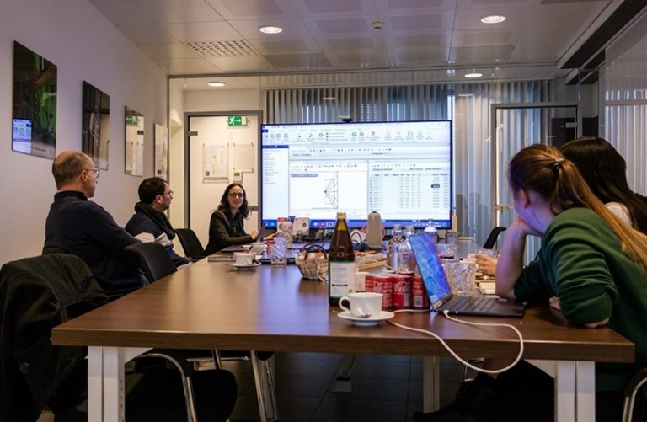
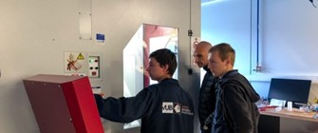

Good practices
Experience Centre Training on optics and freeform optics
Lessons learnt
Results and benefits
Networking and experience
Participants gain inspiration from training examples, connect with B-PHOT’s technology experts and peers, and engage in discussions about photonics and freeform optics applications, helping to identify potential digitalisation challenges.
Test-before-invest projects
A key success measure for the Experience Centre is the return of participants to DIGITALIS for tailored test-before-invest projects.
Improvement of skills applied in the daily work
The participants implement critical design elements from the course into their own system designs and manufacturing processes.
Organising a three-day hands-on course is time-consuming, especially when developing the initial program. However, future editions can benefit from reusable materials and participant feedback for improvements.
To attract enough attendees for the first edition of the course, a video testimonial was created to promote future sessions. Satisfied participants often help spread the word, increasing attendance for subsequent editions.
10% reduction of design-lead time through implementing new designs for manufacturing.
5% increase of productivity was reported by companies that participated in the training.
Images from the three-day experience training

