Slide 1
European Digital Innovation Hubs Network
Driving the EU’s digital transformation

Slide 2
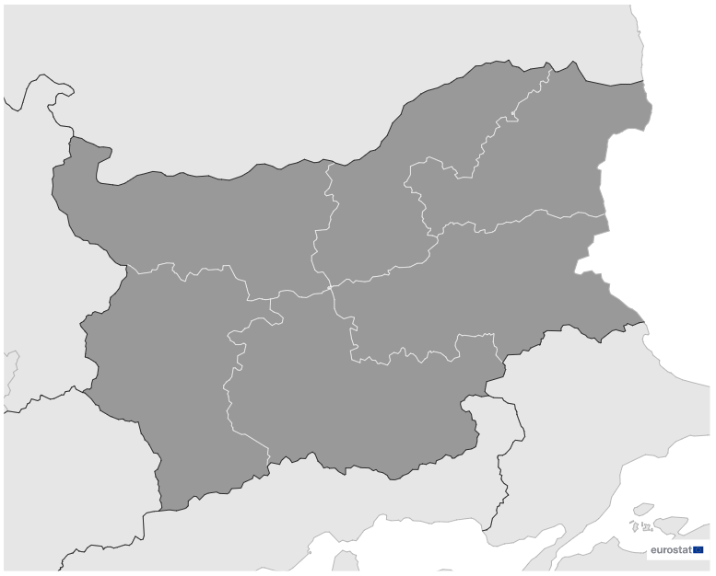
Bulgaria
EDIH
SoE
12
Members
4/12 *EDIHs
8/12 **SoEs
11
4
12
16
Sectors
EDIHs in Bulgaria
1
10
5-8
3
2
9
Concentrate on key sectors such as manufacturing, construction, and healthcare, highlighting their dedication to driving digital innovation.
Play a crucial role in advancing innovation in travel, and the automotive and maritime industries, enhancing efficiency and sustainability through digital solutions.
Focus on smart city initiatives, education, and healthcare, and contribute to the development of advanced technologies.
*European Digital Innovation Hubs
**Seal of Excellence (SoE)
*Funded under Digital Europe Programme

Slide 3
Network overview: 12 members – 4 EDIHs
AgroDigiRise
CYBER4All STAR
EDICS
SynGReDiT

Slide 4
Network overview: 12 members – 8 SoEs
EDIH-NWACB
ADi4SMEs
EDIH DIGIHUB
EDIH-NWACB
InnovationAmp
MECH-E-DIH
RCDSI NCIZ
MECH-E-DIH
Next-Gen-BIoTechEDIH
RCDSI NCIZ
UDIH 4 EU

Slide 5
Services
20 Technologies
Use AI and decision support, digital twins, and cloud services for innovative data analytics and simulations across diverse industries.
Excel in technological innovation, providing cutting-edge solutions tailored to diverse industries.
Focus on simulation engineering, digital twins, and IoT, fostering intelligent solutions in manufacturing, logistics, and human-computer interaction.
Play a pivotal role in innovation through prototyping and technology transfer.
Prioritise cybersecurity, AI and decision support, and robotics, ensuring secure digital ecosystems.
Prioritise ecosystem building, SME support, and financial services, and foster innovation ecosystems, providing crucial support to small enterprises, and facilitating project development through financial assistance.
european-digital-innovation-hubs.ec.europa.eu

