Slide 1
European Digital Innovation Hubs Network
Driving the EU’s digital transformation

Slide 2
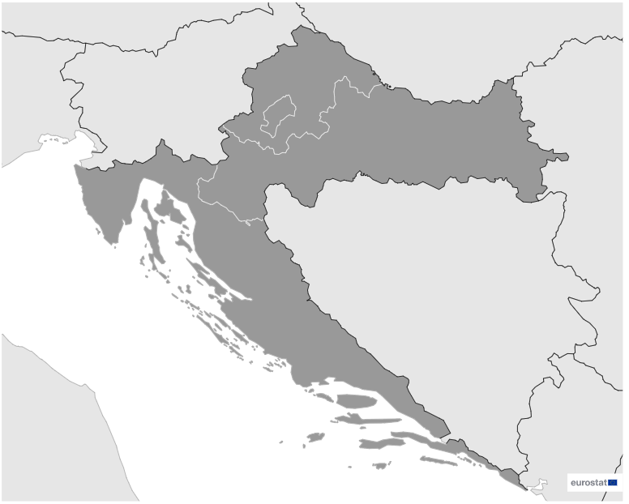
Croatia
EDIH
1
4
Members
4/4 *EDIHs
4
2
3
20
Sectors
EDIHs in Croatia
Focus on pivotal sectors like manufacturing, construction, and healthcare, underscoring their commitment to propelling digital innovation.
Play a crucial role in advancing innovation in the travel, automotive, and maritime industries, leveraging digital solutions to enhance efficiency and sustainability.
Focus on smart city initiatives, education, and healthcare, while actively contributing to the development of advanced technologies..
*European Digital Innovation Hubs
*Funded under Digital Europe Programme

Slide 3
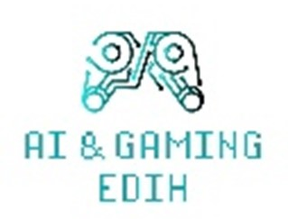
Network overview: 4 members – 4 EDIH
AI4HEALTH.Cro
CROBOHUBplusplus
EDIH Adria
JURK EDIH

Slide 4
Services
14 Technologies
Leverage AI and decision support, big data, and digital twins for advanced data analytics and simulations across diverse industries.
Demonstrate expertise in technological innovation, delivering advanced solutions tailored for various industries.
Lead in high-performance computing, IoT, and robotics, driving intelligent solutions in manufacturing, logistics, and human-computer interaction.
Play a pivotal role in innovation through prototyping and technology transfer, effectively translating research findings into practical and applicable solutions.
Emphasise cybersecurity, virtual reality, and additive manufacturing, ensuring the security of digital ecosystems and spearheading immersive experiences and innovative production processes.
Prioritise ecosystem building, SME support, and financial services, actively fostering innovation ecosystems, supporting small enterprises, and offering financial assistance for projects.
european-digital-innovation-hubs.ec.europa.eu

Slide 5
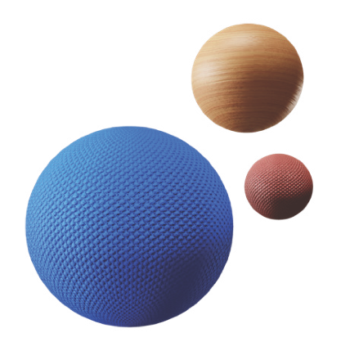
Success stories
Empowering solar energy through IoT
Service type
Challenges
EDIH
Test before invest
3t.Cable faced a challenge in scaling its operations and maintaining high standards without a comprehensive digital monitoring system. The company required a solution for real-time monitoring and predictive maintenance of its solar power plants to improve operational efficiency and sustainability.
CUSTOMER
3t.Cable
Website
Small-sized enterprise (10-49 employees)
Technologies
Solutions
Internet of things (IoT)
Ericsson Insulate Platform: a comprehensive paid solution offering real-time monitoring, energy management, and data visualisation to improve operational efficiency;
Node-RED: an open-source development tool providing flexibility and customisation for monitoring solar power plants without licensing costs;
IoT integration: real-time data collection and analysis through IoT platforms to enable proactive maintenance, optimise performance, and predict potential failures.
Sectors
Energy and environment

Slide 6
Success stories
Empowering solar energy through IoT
Thanks to EDIH ADRIA the SME achieved::
Results and benefits
Real-time monitoring
Integrating IoT platforms enabled 3t.Cable to collect continuous real-time data, detect anomalies early, and take proactive actions. This improved system reliability and reduced downtime.
Maintenance efficiency
Predictive analytics allowed for proactive maintenance scheduling, reducing overall maintenance costs and extending the lifespan of photovoltaic (PV) installations. This resulted in higher returns on investment for clients.
Cost efficiency
Automation and streamlined processes reduced manual intervention, lowering labour costs and improving system performance, leading to increased energy output and significant financial savings.
enhanced operational control: Adria's IoT integration improved 3t.Cable's solar power monitoring, boosting energy management and efficiency;
sustainability leadership: optimised PV efficiency helped 3t.Cable reduce emissions and strengthen its role in renewable energy;
technological leadership:
digital solutions from Adria made 3t.Cable more competitive, enabling it to win larger projects and attract new clients.
Lessons learnt
Selecting the right technology requires a balance between cost, customisability, and ease of use.
Ensuring robust internet connectivity and hardware compatibility is crucial for seamless IoT integration.

