Slide 1
European Digital Innovation Hubs Network
Driving the EU’s digital transformation

Slide 2
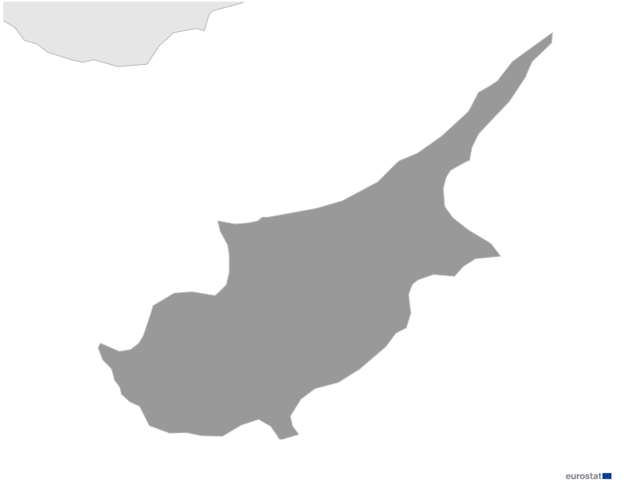

Cyprus
EDIH
1
Member
1/1 *EDIH
3
Sectors
EDIHs in Cyprus
1
The Cyprus EDIH stands at the forefront of fostering digital innovation across various sectors. It plays a pivotal role in the cultural and creative economy and the energy and environment sectors, promoting sustainability and technological advancement in Cyprus.
The EDIH’s initiatives extend to the travel, automotive, and maritime industries, promoting sustainable practices and technological integration.
.
By enhancing public infrastructure, the Cyprus EDIH significantly contributes to smart city projects and impacts education and healthcare.
*European Digital Innovation Hubs
*Funded under Digital Europe Programme

Slide 3
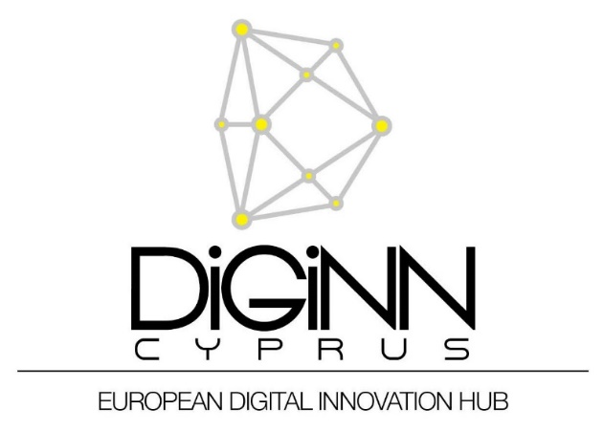
Network overview: 1 member – 1 EDIH
AIRE

Slide 4








Services
3 Technologies
The Cypriot EDIH fosters and outstanding expertise on creating robust and secure digital ecosystems through the use of AI and decision support, big data and cybersecurity technologies.
The Cypriot EDIH offers high quality innovation management and tailored support services, with a primary focus on SMEs.
As a leader in high-performance computing, the development of smart solutions in sectors such as manufacturing, logistics and human-computer interaction is guaranteed in Cyprus.
These services provide resources to fuel the growth and digital transformation of businesses across the country. This support makes this EDIH a key agent for the digital transformation of business in Cyprus.
It also uses virtual reality to create immersive digital experiences.
european-digital-innovation-hubs.ec.europa.eu

Slide 5




Good practices
Virtual time travel: exploring Choirokitia’s past through digital reconstruction
EDIH
Challenges
Solutions
The initiative, a collaboration between the Cyprus Institute and the National Centre for Scientific Research in Paris, uses VR technology to promote Cypriot cultural heritage and economic growth.
It addresses the difficulty in interpreting complex archaeological and historical information by offering interactive and immersive visualisations, aligning with UNESCO’s directives and enhancing the understanding of cultural landscapes and sites.
The initiative employs VR-enabled collaborative sessions to aid stakeholders in comprehending complex archaeological data.
It enhances digitalisation and visualisation in archaeology, cultural heritage, and museum education through advanced 3D documentation and modelling techniques, improving public engagement and interpretation of intricate 3D data.
Originally funded to assess the management plan of the UNESCO World Heritage site of Choirokitia, the initiative now also supports educational and tourism applications.
Services
Test before invest
Technologies
Virtual reality
Sectors
Cultural and creative economy

Slide 6


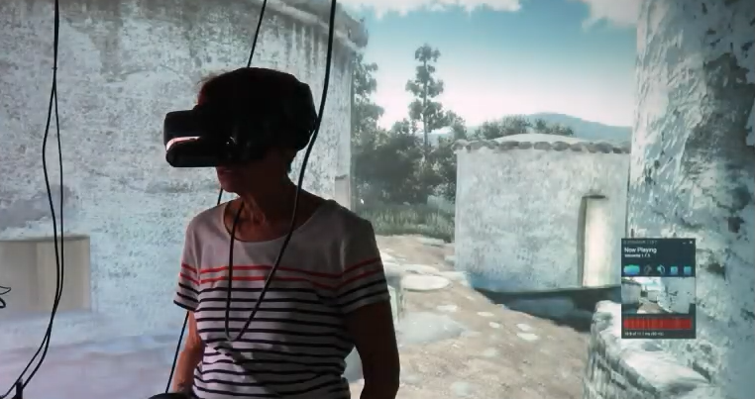
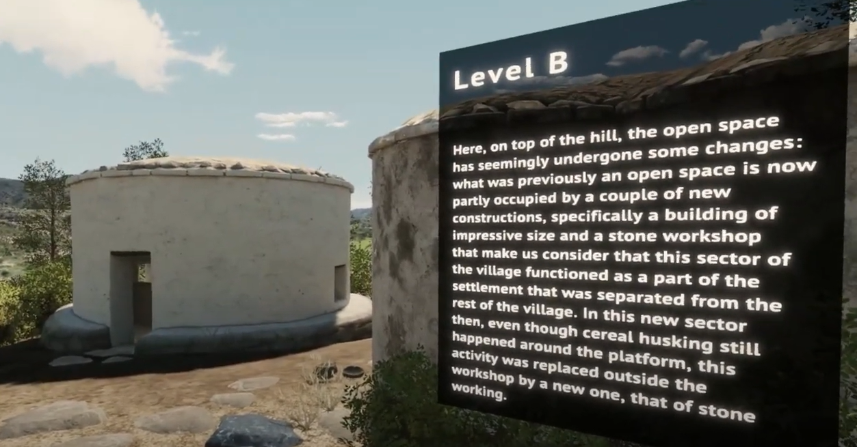

Good practices
Virtual time travel: exploring Choirokitia’s past through digital reconstruction
Results and benefits
Lessons learnt
New interpretations
Experts dived into virtual realms to test bold hypotheses and scenarios, unraveling the physical and social evolution of sites like never before.
Better understanding leading to better protection
Merging environmental and archaeological data allowed a comprehensive understanding of the relationship between environment and archaeology.
Greater public awareness
The combination of the input from both archaeologists and visualisation researchers provides a more engaging experience for visitors.
Optimise 3D spatial data.
Create a co-creation lab with the right tech for customer-specialist collaboration on immersive visualisations.
Develop a clear, structured work plan for effective collaborative projects.
Encourage customers to reflect, question past choices, and test new scenarios;
Prioritse in-person co-design sessions over remote interactions due to superior performance outcomes.
Use 3D rather than 2D.
Embrace iteration – multiple evaluation and co-creation sessions are essential for success.
Showcase of the VR animated walkthrough generated from research conducted at the Cyprus Institute about Choirokitia.

Slide 7

Success stories
Uncovering hidden vulnerabilities: SME’s security overhaul success
Service type
Challenges
EDIH
Test before invest
Develop a robust defense mechanism to secure their data from cyber threats and internal risks, ensuring maximum protection without unnecessary complexity or embellishment.
CUSTOMER
Medium-sized enterprise
Specialised in genetic testing
50-249 employees
Annual turnover of €1,510,200.
Technologies
Solutions
Cybersecurity
Comprehensive penetration testing service of five scenarios, featuring both internal and external assessment, including:
      simulation of a malicious actor targeting the external facing systems;
    simulation of a malicious actor located inside the organisation's network;
    assessment of a web application.
Sectors
Healthcare
EDIH DiGiNN Cyprus covered 95% of initial testing costs, leading the SME to fund security upgrades.

Slide 8


Success stories
Uncovering hidden vulnerabilities: SME’s security overhaul success
Thanks to EDIH DiGiNN the SME achieved::
Results and benefits
Enhanced security posture
Proactively identifying and rectifying vulnerabilities strengthens overall system security and fortifies against unauthorised access.
Potential costs avoided
The costs associated with data breaches such as downtime, fines and reputation damage are avoided.
Competitive advantage
Investing in cybersecurity safeguards protects the SME's assets and reputation, fosters customer trust, and strengthens its competitive edge in the market.
cost and time savings:
an estimated €5,000 savings from PenTest services;
reduction in vulnerabilities:
seven important vulnerabilities identified through the service, expecting:
a reduction of 60% immediately after the service;
an 80% reduction once the restructuring is completed.
Lessons learnt
SMEs should stay informed about their system security and technologies and keep up to date on industry developments.
Identified risks must always be considered when assessing new technologies to be used.

