Slide 1
European Digital Innovation Hubs Network
Driving the EU’s digital transformation

Slide 2
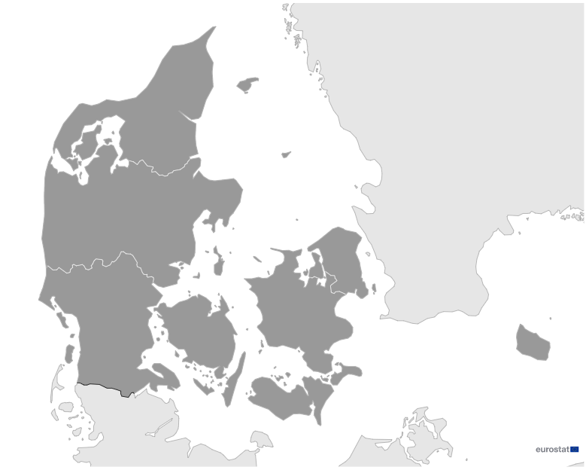
Denmark
EDIH
5
Members
4
5/5 *EDIHs
3
10
Sectors
EDIHs in Denmark
5
Advance innovation in areas such as agricultural biotechnology and food biotechnology, education, and environment.
Focus on sectors like smart cities, consumer products, and construction and assembly, and contribute significantly to the development of advanced technologies.
1
Concentrate on crucial sectors, including manufacturing and processing, public administration, and energy, demonstrating their dedication to driving digital innovation.
2
*European Digital Innovation Hubs
*Funded under Digital Europe Programme

Slide 3
Network overview: 5 members – 5 EDIHs
AddSmart
CD-EDIH
EDOcobot
GC EDIH
GC EDIH
SEDIH

Slide 4
Services
13 Technologies
Leverage cutting-edge technologies such as artificial intelligence and decision support, big data, and digital twins to revolutionise data analytics and simulation techniques across a spectrum of industries.
Demonstrate excellence in technological innovation, delivering cutting-edge solutions tailored for diverse industries.
Lead in Denmark by prioritising high-performance computing, IoT, and robotics, fostering intelligent solutions in manufacturing, logistics, and human-computer interaction.
Play a pivotal role in innovation through prototyping and technology transfer, effectively translating research findings into practical and applicable solutions.
Specialise in cybersecurity, virtual reality, and additive manufacturing, contributing to secure digital ecosystems and pioneering immersive experiences, all while driving innovative production processes.
Prioritise ecosystem building, SME support, and financial services, actively fostering innovation ecosystems, supporting small enterprises, and offering financial assistance for projects.
european-digital-innovation-hubs.ec.europa.eu

