Slide 1
European Digital Innovation Hubs Network
Driving the EU’s digital transformation

Slide 2
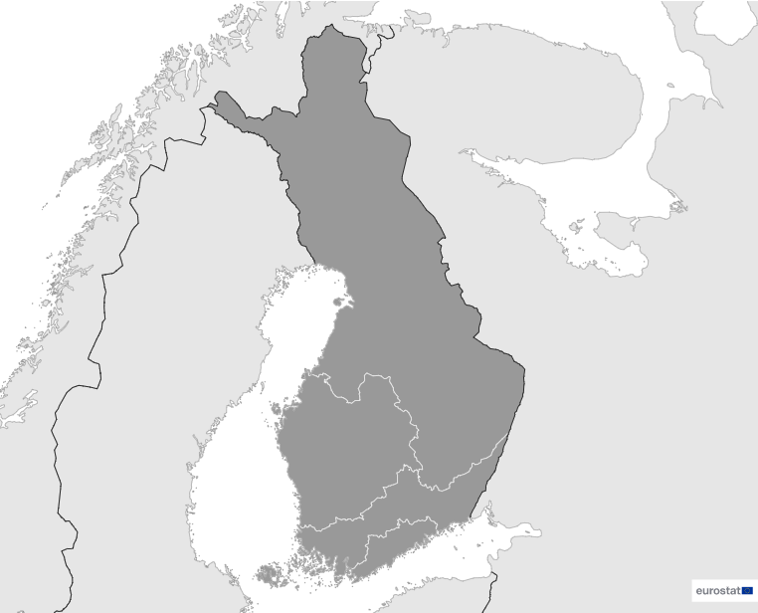

Finland
EDIH
4
Members
4/4 *EDIHs
19
Sectors
EDIHs in Finland
Drive digital innovation in key sectors, including manufacturing, construction, healthcare, and energy, fostering advancements in these industries.
Advance innovation in the transport, maritime, and energy sectors, enhancing efficiency and sustainability through the implementation of digital solutions.
Focus on smart city initiatives, healthcare, and environmental solutions, contributing to the development of advanced technologies.
4
1
3
2
*European Digital Innovation Hubs
*Funded under Digital Europe Programme

Slide 3




Network overview: 4 members – 4 EDIHs
FAIR
HHFIN
LIH
Robocoast

Slide 4








Services
23 Technologies
Leverage cutting-edge technologies such as artificial intelligence and decision support, big data, and digital twins to drive innovative data analytics and simulation techniques across various industries.
Engage in field trials, committing to the practical testing and implementation of innovative solutions.
Prioritise high-performance computing, IoT, and robotics, fostering intelligent solutions in manufacturing, logistics, and human-computer interaction.
Prioritise ecosystem building, knowledge transfer, and SME support to foster innovation.
Ensures the development of secure digital ecosystems and the exploration of immersive experiences and innovative production processes in key areas such as cybersecurity, virtual reality, and additive manufacturing.
Encourage technology transfer and circular economy initiatives.
https://european-digital-innovation-hubs.ec.europa.eu/home

Slide 5





Good practices
Geospatial Challenge Camp: pioneering health and well-being with young innovators in location intelligence industry
EDIH
Challenges
Solutions
It is essential to enhance Finland's geospatial competence and innovation, boosting advancements in open data, technology, and location data research. This is vital for tackling urgent health and well-being issues, such as inadequate public health services, health disparities, and the impacts of infectious diseases. Finland has struggled with healthcare system re-organisation and youth mental health recovery post-COVID-19.
Leveraging location technology and Finland's rich open-access data can improve the understanding and management of these challenges, aiding in better health resource assessment and allocation.
The Geospatial Challenge Camp (GCC) is a 10-week event and course for young researchers, students, and professionals to solve real-world issues using geospatial data and digital technology. Co-created by the University of Turku, Aalto University, the National Land Survey of Finland, and CSC, the GCC debuted in 2023 with a focus on health and well-being. This year's challenges included improving the climate friendliness of health services for Varha, assessing urban climate risks for the City of Turku, and creating health service wayfinding maps for Citynomadi. The GCC emphasises sustainable, economically, environmentally, and socially responsible solutions.
Services
Training and skills development
Technologies
Data, high-performance computing, location-based applications
Sectors
Healthcare

Slide 6
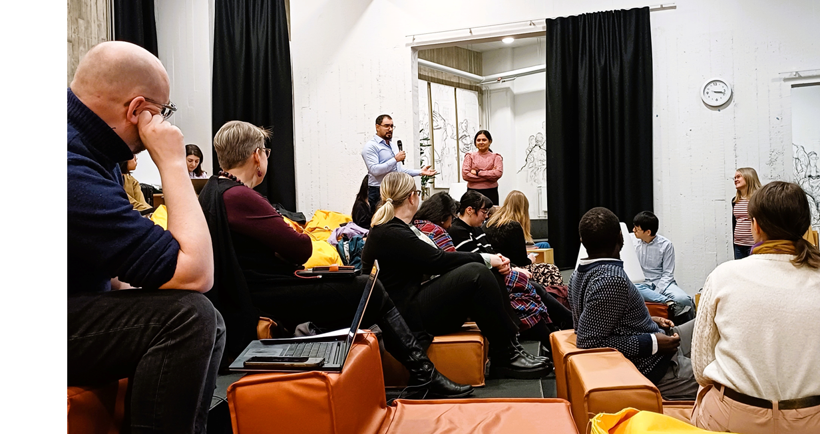


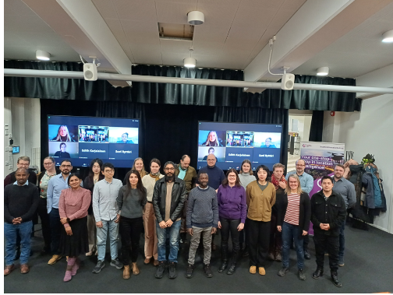

Good practices
Geospatial Challenge Camp: pioneering health and well-being with young innovators in location intelligence industry
Results and benefits
Lessons learnt
Innovation in entrepreneurship
The camp's collaborative nature fosters innovation by uniting diverse stakeholders, boosting skills in co-creation, problem-solving, and teamwork.
Development of soft skills
GCC provides a cost-effective way for customers to test and innovate solutions without immediate investment in full development, thereby mitigating financial risks. It also offers researchers and students valuable real-world experience, enhancing their professional and soft skills, and boosting their future job prospects in the location industry.
Offers hands-on learning for addressing complex societal issues through collaboration and new learning;
Enhances professional skills and work-life connections for researchers and students;
Effective teamwork and communication, supported by weekly mentoring, were key to successful prototype development;
Preparation for the event requires up to a year, with clear themes and timely partner engagement being crucial;
Follow-up is essential to track prototype development and continued progress.
Images of the students and researchers that participated in the 10-week programme of the Finnish Geospatial Challenge Camp

Slide 7

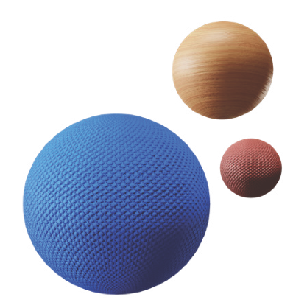

Success stories
Breaking boundaries: Innocode gained game-changing connections through the Robocoast EDIH consortium
Service type
Challenges
EDIH
Networking and access to innovation ecosystems
Develop the Innocode P100, an advanced AI-based system designed for predictive maintenance, aiming to detect anomalies by creating unique system fingerprints within a week, preventing unplanned production losses and equipment failures. Innocode is seeking expert assistance and new partnerships to support product testing, development, and market launch.
Technologies
CUSTOMER
Innocode
Website
Micro-sized enterprise with 1-9 employees
Communication network
Solutions
Sectors
Identification of AI expertise data analysis;
Facilitations of connections through digital marketing tools;
Development of a suitable testing environment.
Security

Slide 8

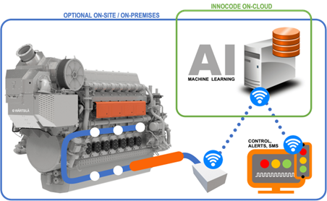

Success stories
Breaking boundaries: Innocode gained game-changing connections through the Robocoast EDIH consortium
Thanks to ROBOCOAST the SME achieved:
Results and benefits
Deep industrial know-how
Innocode will benefit from significant industry expertise and advanced testing facilities for their AI technology through their partnership with the Robocoast network. This collaboration has already led to valuable business connections and opportunities, making Innocode confident they have the ideal partners for their P100 product's success.
Time savings on sales and marketing
Robocoast has enabled Innocode to save 1-1.5 years of individual sales and marketing work. They also have the chance to attend major trade fairs with a new partner in April 2024, avoiding approximately €10,000 euros in organisational expenses.
Worldwide collaboration
Investing in sales, material production and product development with multiple partners.
savings equivalent to a full-time pension for 1-1.5 years in marketing and sales, and avoidance of testing costs estimated at €1,200 per day for three days;
opportunity to participate in an important trade fair of €10,000 to showcase their new product for potential customers.
Lessons learnt
Strategically identify and integrate specialised partners (AI solution providers, marketing experts, 3D printing specialists) with industry-specific expertise.
Optimise synergy between digital and traditional marketing approaches.
Showcase of the AI product designed by ROBOCOAST partners

