Slide 1
European Digital Innovation Hubs Network
Driving the EU’s digital transformation

Slide 2
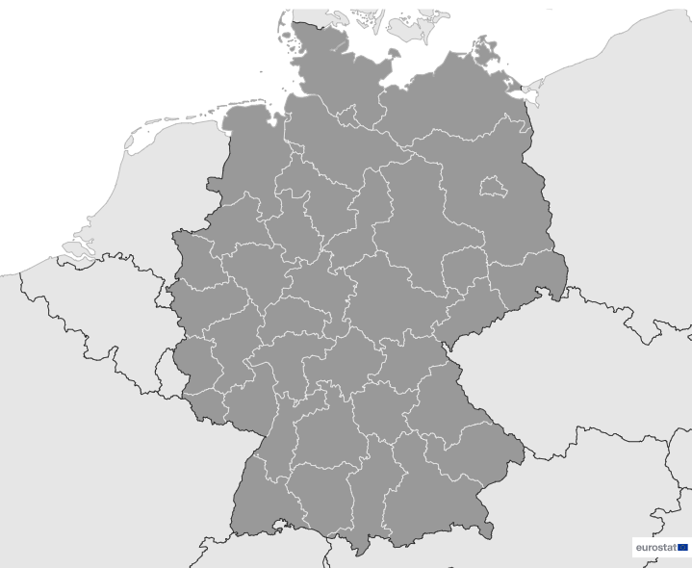
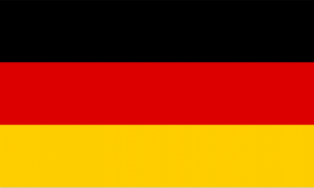
Germany
EDIH
SoE
12
10
11
17
Members
16/17 *EDIHs
13
1/17 **SoE
14
8
16
26
Sectors
15
EDIHs in Germany
9
7
6
5
Include sectors such as manufacturing, automotive, public administration, and healthcare.
Play a key role in driving innovation ecosystems across sectors such as transportation and mobility, smart city initiatives, and energy.
Focus on sectors such as aeronautics, life sciences, and the cultural and creative economy, enhancing the vibrant landscape of digital innovation.
3
4
2
17
1
*European Digital Innovation Hubs
**Seal of Excellence (SoE)
*Funded under Digital Europe Programme

Slide 3





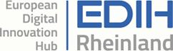





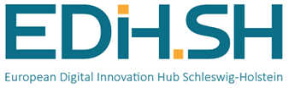




Network overview: 17 members – 16 EDIHs
BMH
CITAH
DIH4AISec
DInO
EDIH-AICS
EDIH DIGICARE
EDIH Rheinland
EDIH Saarland
EDIH Saxony
EDIH-SH
EDIH Suedwest
EDIH Suedwestfalen
EDIH4UrbanSAVE
EDIHDO
EDITH
Pro_digital

Slide 4

Network overview: 17 members – 1 SoE
AIRE

Slide 5
Driving the EU’s digital transformation
#EDIH_Network
24
Technologies
Services
Leverage cutting-edge technologies, such as artificial intelligence and decision support, big data, and digital twins.
Lead in innovation management, excelling in prototyping, SME support, field trials, and technology transfer.
Lead in advancing high-performance computing, IoT, and robotics, fostering intelligent solutions in manufacturing, logistics, and human-computer interaction.
Prioritise ecosystem building, demonstrating their commitment to fostering innovation ecosystems.
Focus on key areas like cybersecurity, virtual reality, and additive manufacturing.
Play a key role in technological innovation and regional development through knowledge transfer.
https://european-digital-innovation-hubs.ec.europa.eu/home

Slide 6






Good practices
Connecting regions: the international workshop on smart cities
EDIH
Challenges
Solutions
Cities and municipalities encounter considerable challenges in their efforts to become smarter and more efficient, especially in mobility, energy, and tourism. In Saxony, where many municipalities are small, it's essential to keep local leaders updated on the latest technological advancements.
EDIH Saxony, committed to overcoming these challenges, fosters active stakeholder collaboration and maintains an international perspective. This strategy aims to expedite the transition towards smarter, more resilient cities and regions.
EDIH Saxony tackled the challenge of advancing smart cities and regions by hosting the international workshop ‘Smart Cities & Regions’ with partners from Germany, Poland, and the Czechia.
Innovative digital solutions are vital for future cities and regions and, addressing emerging challenges. Despite the difficulties of digital transformation for public administration, it offers significant opportunities to improve efficiency, living standards, and regional value chains. Embracing digitalisation can streamline public services, enhance connectivity, and promote sustainability and economic growth.
Services
Networking and access to innovation ecosystems
Technologies
Cybersecurity
AI and decision support
Big data
Sectors
Smart cities

Slide 7
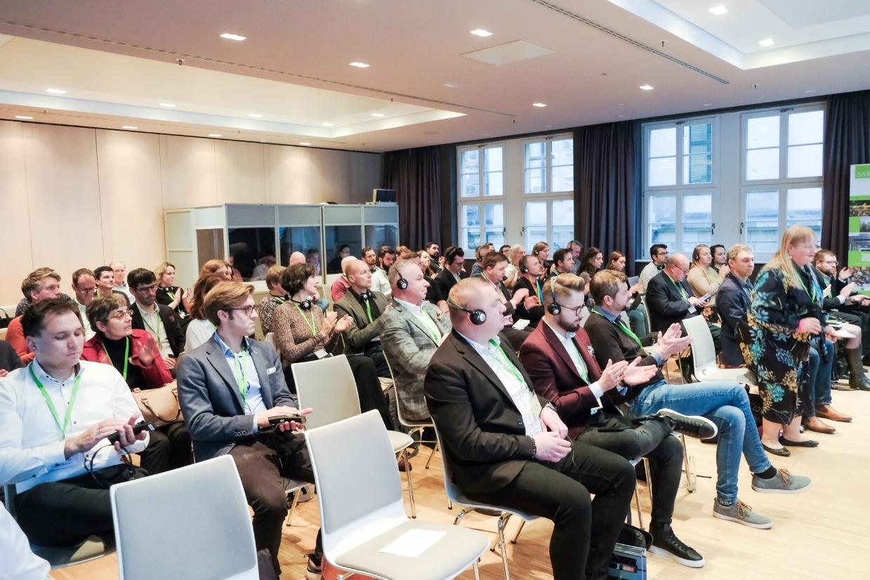


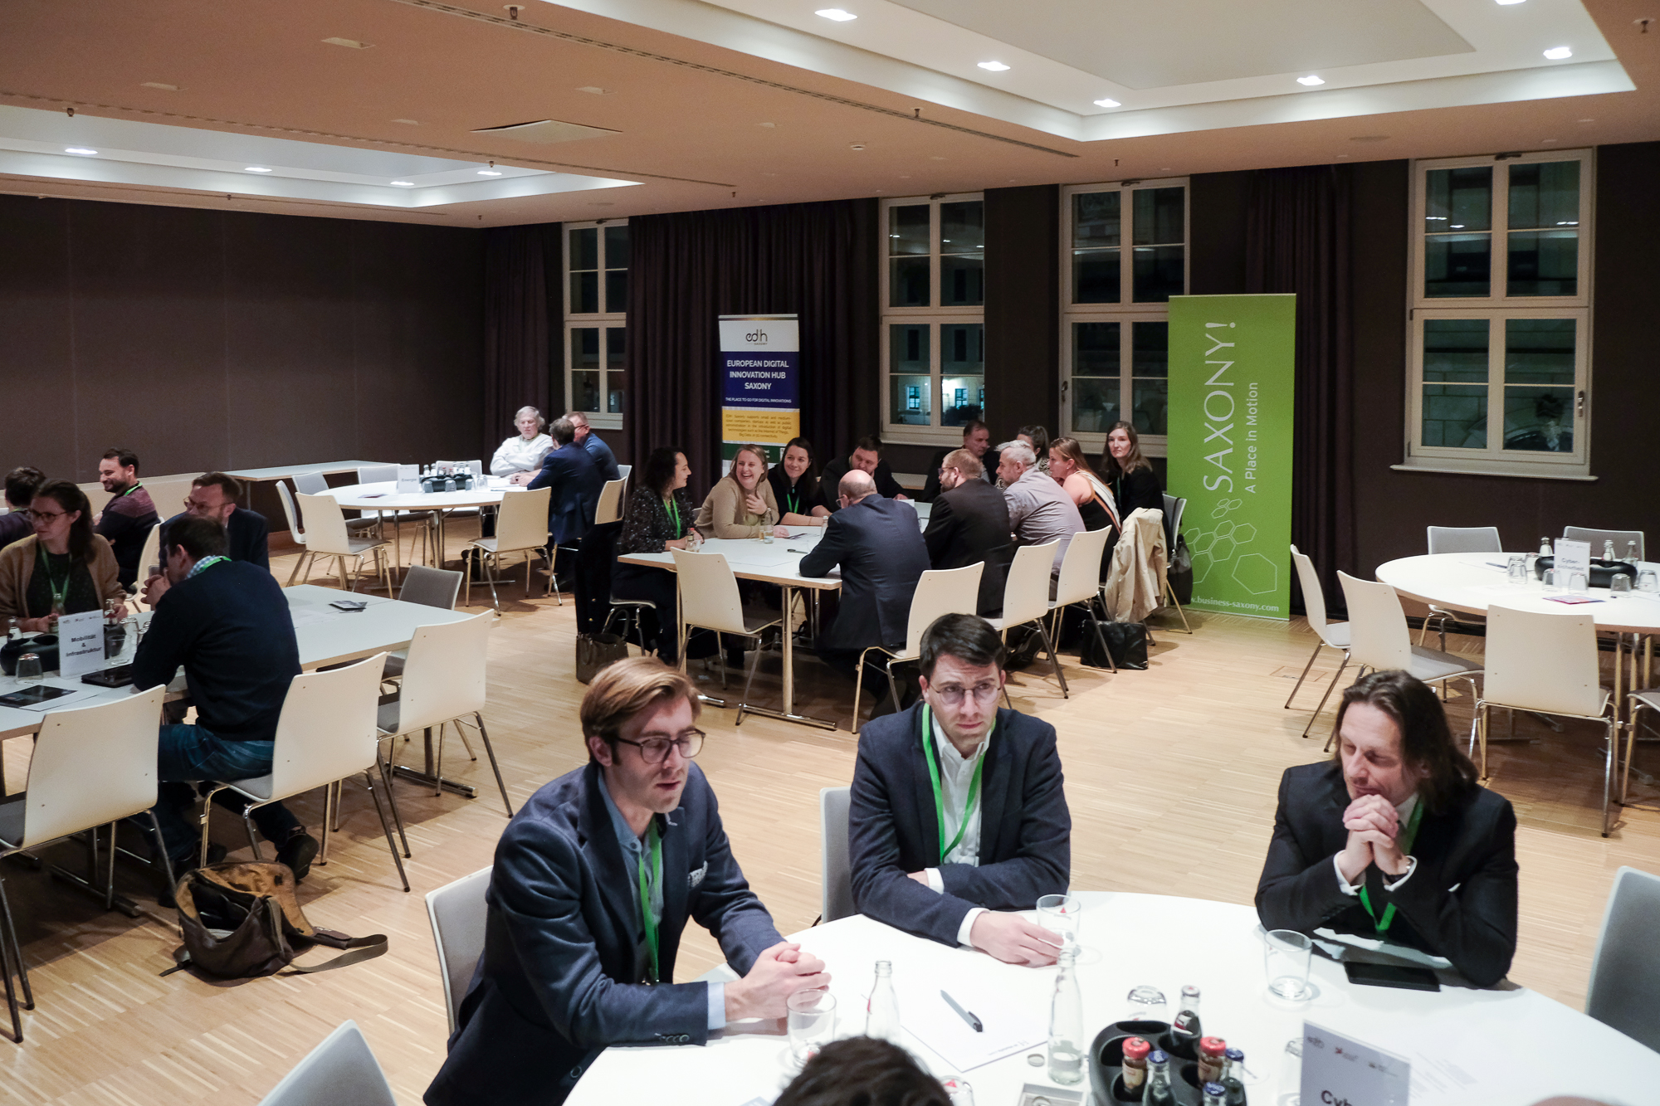

Good practices
Connecting regions: the international workshop on smart cities
Results and benefits
Lessons learnt
Benefits for municipalities
Start-ups dove deep into understanding the unique needs and challenges of local governance. This hands-on exploration led to tailor-made, innovative solutions that addressed the specific dynamics of each community.
Benefits for the start-ups
Experience exchange, best practices, and knowledge sharing was promoted, fostering cross-border collaboration between Germany, Poland, and Czechia, leveraging diverse regional expertise.
Benefits for EDIHs
The EDIHs behind the event scored big on collaboration, gaining rich insights into the digital innovation landscape.
Foster cross-border partnerships with other EDIHs for diverse expertise and knowledge sharing.
Engage professional interpreters for clear communication at international events.
Provide start-ups opportunities to pitch their innovative solutions to stakeholders.
Encourage interdisciplinary collaboration by bringing together actors from various sectors.
Maintain a balanced agenda, prioritising quality over quantity to ensure adequate attention and a diverse selection of start-ups.
This dynamic event brought together 89 participants from Czechia, Germany, and Poland!
Showcase of the workshop ‘Connecting regions: the international workshop for smart cities and regions’

Slide 8



Success stories
Supporting Gas Grün GmbH's success in AI, marketing and prototyping using 3D printing.
Service type
Challenges
EDIH
Test before invest
Networking and access to innovation ecosystems
Optimise biogas plant efficiency through advanced AI, enhance prototyping and visual communication with 3D printing, and increase market visibility to showcase their environmental and technological innovations.
CUSTOMER
Gas Grün GmbH
Website
Micro-sized enterprise with 1-9 employees.
Technologies
Solutions
AI and decision support
Completed comprehensive penetration testing (T0 DMA measurement to assess digital maturity).
Developed a customised control system for optimising biogas plant efficiency and enhancing automation.
Facilitated connections with marketing partners experienced in the sustainable energy sector.
Established 3D printing collaboration.
Sectors
Energy, fuels and petroleum engineering

Slide 9
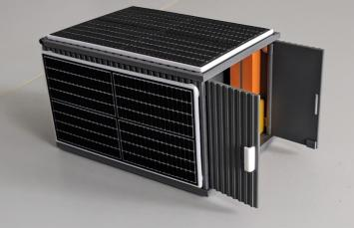

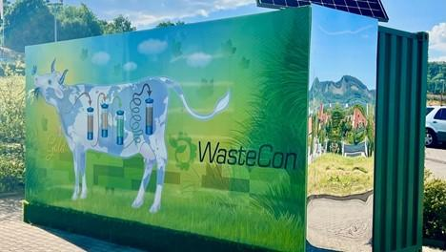

Success stories
Supporting Gas Grün GmbH's success in AI, marketing and prototyping using 3D printing
Thanks to EDIH pro_digital the SME achieved::
Results and benefits
Operational improvement
Demonstrated how digital transformation can benefit start-ups and SMEs;
Enhanced efficiency
Aligned with sustainability objectives by optimising resource use and reducing environmental impact;
Innovative impact
Contributed to broader climate change efforts and promoted sustainable practices within the community.
increased efficiency:
operational processes have been optimised, allowing for improved automation and real-time monitoring by 20%;
accelerated product development:
product development cycle was accelerated by 30% as a result of using 3D printing;
increased Gas Grüns’ visibility:
Gas Grüns’ visibility increased by 30% within the sustainable energy sector.
3D-printed container prototype and final container of Gas Grün GmbH
Lessons learnt
Strategically identify and integrate specialised partners (AI solution providers, marketing experts, 3D printing specialists) with industry-specific expertise.
Optimise synergy between digital and traditional marketing approaches.

