Slide 1
European Digital Innovation Hubs Network
Driving the EU’s digital transformation

Slide 2
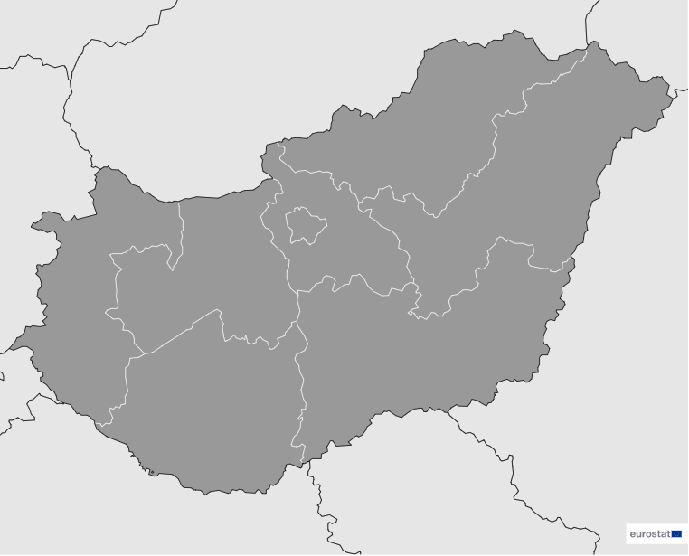
Hungary
EDIH
5
Members
5/5 *EDIHs
1-5
9
Sectors
EDIHs in Hungary
Prominent in education, financial services, and public administration, demonstrating their commitment to advancing digital solutions in key societal sectors.
Actively contribute to innovation in the automotive, construction and assembly, and energy sectors.
Prioritise smart city initiatives, education, and healthcare, playing a significant role in developing cutting-edge technologies.
*European Digital Innovation Hubs
*Funded under Digital Europe Programme

Slide 3
Network overview: 5 members – 5 EDIHs
AEDIH
AI EDIH Hungary
Data-EDIH
DigitalTech EDIH
HPC EDIH HU

Slide 4
Services
12 Technologies
Leverage cutting-edge technologies such as blockchain and distributed ledger technology (DLT), cybersecurity, and cyber-physical systems, demonstrating their commitment to secure resilient digital infrastructures.
Demonstrate expertise in knowledge transfer, empowering industries with cutting-edge insights and fostering collaborative learning across diverse sectors.
Excel in harnessing the power of big data, artificial intelligence and decision support, and cloud services to lead innovation in data-driven analytics and advanced computing solutions.
Advance SME business development through prototyping and assistance on the management of technological innovation.
Actively engage in the development of internet services and applications, internet of things, and robotics, contributing to the advancement of smart technologies that enhance connectivity and automatisation.
Focus on vocational training and skill development, while boosting public sector innovation and fostering a dynamic innovation landscape through comprehensive services.
european-digital-innovation-hubs.ec.europa.eu

