Slide 1
European Digital Innovation Hubs Network
Driving the EU’s digital transformation

Slide 2
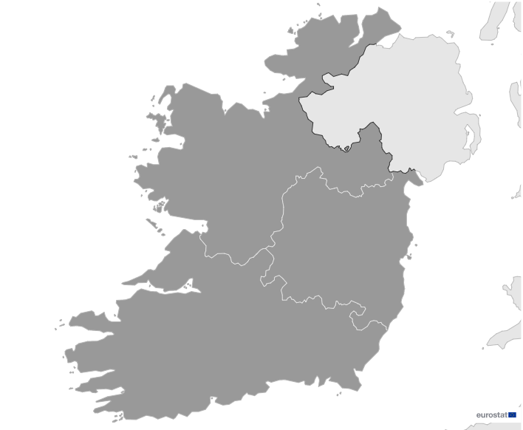

Ireland
EDIH
SoE
4
Members
2/4 *EDIHs
3
2/4 **SoEs
21
Sectors
EDIHs in Ireland
1
2
Exhibit expertise in diverse sectors including food and beverages, telecommunications, and manufacturing, demonstrate a comprehensive approach to digital innovation.
They play a pivotal role in advancing technological solutions, contributing to the transformation of sectors such as travel and tourism, smart cities, and life sciences.
Additionally, they focus strategically on education, financial services, and healthcare, fostering innovation and driving advancements in technology.
4
*European Digital Innovation Hubs
**Seal of Excellence (SoE)
*Funded under Digital Europe Programme

Slide 3


Network overview: 4 members – 2 EDIHs
CeADAR
FxC

Slide 4


Network overview: 4 members – 2 SoEs
Data2Sustain
ENTIRE

Slide 5








Services
17 Technologies
Lead technological innovation, employing artificial intelligence and decision support, big data, and high-performance computing to drive data analytics and simulation techniques across various industries.
Excel in smart specialisation strategies, providing targeted support for innovation in key sectors.
Play a lead role in advancing smart solutions, particularly in manufacturing, logistics, and human-computer interaction, leveraging technologies such as high-performance computing, IoT, and robotics.
Play a crucial role in advancing circular economy initiatives, prototyping, and innovation management.
Place strategic emphasis on cybersecurity, virtual reality, and additive manufacturing.
Prioritise regional development, SME support, and technology transfer, to foster innovation ecosystems.
european-digital-innovation-hubs.ec.europa.eu

Slide 6





Success stories
Condition-based monitoring of injection moulding machines using real-time machine data
Challenges
Service type
EDIH
TPS faced delays in production reporting, difficulties tracking maintenance needs, and an inability to capture real-time machine data or accurately measure energy and CO2 emissions. These issues impacted production efficiency, cost management, and sustainability efforts.
Support to find investment
CUSTOMER
Total Plastic Solutions
Website
Small-sized enterprise (10-49 employees).
Technologies
Digital twins
Solutions
Real-time monitoring system: developed to capture live machine data, enabling predictive maintenance and tracking energy use and CO2 emissions.
Edge device: installed to monitor machine status, energy consumption, and tool usage in real time.
Dashboard with alerts: created to display KPIs and send notifications when thresholds are exceeded.
Sectors
Manufacturing and processing

Slide 7



Success stories
Condition-based monitoring of injection moulding machines using real-time machine data
Thanks to EDIH FxC the SME achieved::
Results and benefits
Reduced downtime and repair costs
TPS's condition-based monitoring system identified and addressed equipment issues before failures occurred, reducing unscheduled downtime and repair costs, while also minimising raw material waste.
Increased profit margins
With better cost calculations through real-time data on energy and tool usage, TPS improved pricing accuracy for customers, leading to higher profit margins.
Sustainability improvements
The monitoring system's ability to track energy use per part helped TPS optimise machine efficiency, reduce energy consumption, and cut the carbon footprint of production, aligning with both business and sustainability goals.
real-time monitoring:
TPS developed a system that continuously monitors machine components and energy use, enabling predictive maintenance and reducing downtime;
energy efficiency and sustainability:
TPS identified inefficiencies through captured real-time data, such as unnecessary energy consumption by hydraulic machines.
Lessons learnt
Set clear goals: define project goals thoroughly from the beginning to improve execution and tracking.
Control scope creep: focus on the project’s core objectives and manage additional ideas to avoid delays.

Slide 8



Good practices
Process to scale EDIH service delivery and an example of a client pathway
Technologies
EDIH
Artificial intelligence and decision support, cybersecurity, internet of things (IoT), software architectures, internet services and applications, and virtual reality
Challenges
The ENTIRE EDIH, based in southern Ireland, possesses extensive expertise in AI, cybersecurity, IoT, and digital transformation to support SMEs and PSOs. However, while the EDIH model has proven highly effective in connecting organisations with digital experts, its rapid success has created challenges in scaling service delivery efficiently. With multiple stakeholders involved, maintaining accurate administration, reporting, and structured service expansion has become essential to ensure smooth operations.
Solutions
Needs defined stakeholder roles and responsibilities: established a structured service delivery framework, outlining clear responsibilities for the service provider, consortium lead, national funder, EDIH Network, and clients to ensure seamless coordination and reporting.
Tiered approach for service delivery: introduced a multi-tier service model, integrating the Digital Maturity Assessment (DMA) in Tier 1, allowing clients to assess digital gaps before advancing to more in-depth support services.
Systematic tracking and reporting: implemented structured progress tracking, generating short reports at each service tier, capturing DMA scores, service outcomes, and next steps to optimise future engagements.

Slide 9

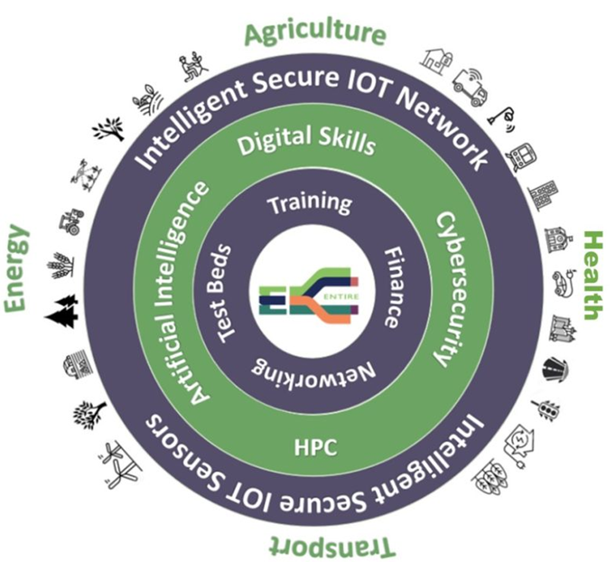


Good practices
Process to scale EDIH service delivery and an example of a client pathway
Lessons learnt
Results and benefits
Introduce clients properly to EDIH: clearly explain the EDIH model, the DMA’s purpose, and available funding to ensure clients fully understand and engage with the support system.
Establish structured processes before scaling: define and document a structured, end-to-end process to ensure high-quality service delivery.
Ensure cross-functional team involvement: engage finance, marketing, and other key departments.
Successful client case: Place Engage Ltd
The EDIH supported Place Engage Ltd. from discovery and assessment to technology analysis, enabling them to secure an Innovation Voucher and develop a roadmap for platform development.
Expanded service portfolio and rapid scaling
The EDIH successfully designed a comprehensive portfolio of over 40 tailored services, allowing them to scale service delivery quickly and efficiently.
High demand and client engagement
Within the first months, ENTIRE EDIH conducted 51 Digital Maturity Assessments (DMAs) and delivered 61 services, demonstrating strong demand and effective outreach.
Within the first months, 51 DMAs and 61 services were delivered, demonstrating the EDIH’s rapid scaling and strong client engagement.
Images from the service delivery and client pathway

