Slide 1
European Digital Innovation Hubs Network
Driving the EU’s digital transformation

Slide 2
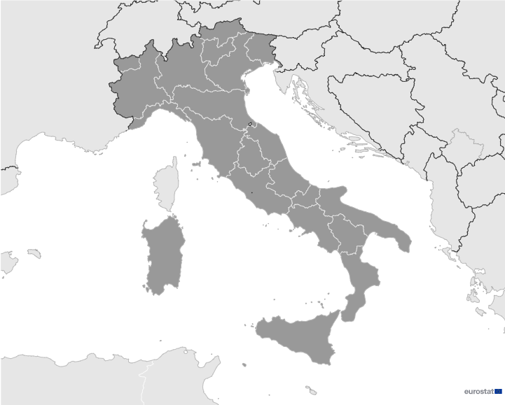

Italy
EDIH
SoE
35
36
28
29
12
32
11
27
37
Members
13/37 *EDIHs
34
31
10
13
30
33
26
24/37 **SoEs
19
25
37
8
24
7
9
23
19
22
20
18
38
Sectors
EDIHs in Italy
21
5
17
4
16
6
3
1
2
14
Italian EDIHs cover a broad range of sectors, including manufacturing, travel and tourism, healthcare, and public administration.
The goal of these hubs is to drive efficiency and progress through the adoption of digital solutions in key areas such as automotive, energy, and environmental sustainability.
With a strategic focus on smart city initiatives, education, and healthcare, Italian EDIHs actively contribute to the development and implementation of cutting-edge technologies throughout the country.
15
*European Digital Innovation Hubs
**Seal of Excellence (SoE)
*Funded under Digital Europe Programme

Slide 3
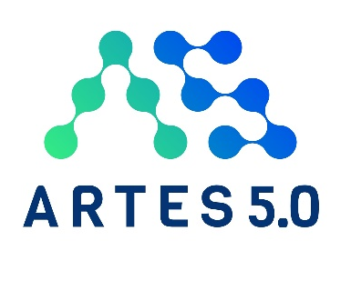











Network overview: 37 members – 13 EDIHs
ARTES 5.0
CETMA-DIHSME
CHEDIH
DANTE
DIHCUBE
EDIH4Marche
ER2Digit
EXPAND
HSL
I-NEST
MicroCyber
P.R.I.D.E.
Tuscany X.0

Slide 4









Network overview: 37 members – 24 SoEs
AI-PACT
AP-EDIH
CATCH
atMIND
AI MAGISTER
AI-PACT
AP-EDIH
CATCH
atMIND
DAMAS
AI MAGISTER
AI-PACT
Ap-EDIH
BIREX plus plus
CATCH atMIND
DAMAS
EDIHAMo
DIPS
DIS-HUB
DMH
EDIHAMo
DIPS
DIS-HUB
DMH
DIPS
DIS-HUB
DMH
EDIH L
EDIH4DT
EDIHAMo
Fondazione MAXXI
Fondazione MAXXI
INNOVA
InnovAction
INNOVA
InnovAction
Fondazione
HD-MOTION
INNOVA
InnovAction
IP4FVG - EDIH
NEST
MAXXI
NEURAL
PAI
NEURAL
PAI
NEURAL
PAI
PICS2
R.O.M.E.
SharD-HUB
UDD
Digital Hub

Slide 5
Driving the EU’s digital transformation
#EDIH_Network
34
Technologies
Services
Italian EDIHs leverage cutting-edge technologies, such as artificial intelligence, big data, and digital twins, to reshape the way businesses benefit from data analytics and simulation techniques.
One of the main services provided by Italian EDIHs is ecosystem building, creating collaborative innovation environments that lead technological advancements and stimulate economic growth.
New possibilities in various sectors can be explored with the expertise of the EDIHs in high-performance computing, internet of things, and robotics.
Through SME support and finance services, the hubs offer resources and guidance to companies, actively contributing to the developments of a resilient business ecosystem.
With a focus on cybersecurity, Italian EDIHs can ensure safety and reliability in digital environments. In addition, they engage in important technologies for industrial sectors, such as additive manufacturing and virtual reality.
european-digital-innovation-hubs.ec.europa.eu

Slide 6







Success stories
Harvesting success: Piedmont’s digital agriculture breakthrough
Challenges
Service type
EDIH
A single tool was needed to verify that plots of land are effectively employed for their intended use. This entailed two challenges:
not all areas are covered and there are limitations to surveillance using satellites and continuous remote sensing;
the resolution of the satellite images is not good enough to verify the dynamic use of land.
Test before invest
CUSTOMER
ARPEA – PSO
Specialised in the agricultural sector
Medium-sized PSO with 50-249 employees.
Technologies
Solutions
Internet of things and data
ARPEA adopted a ‘satellite magnifying glass’ equipped with a higher resolution and coupled with the stereoscopic capacity of airborne cameras, including both RGB and multispectral.
This enhanced solution enables mapping thousands of hectares within a single flight, utilising general aviation aircraft equipped with the same sensor-based technologies that are carried aboard satellites. This technology allows high resolution mapping of remote parts of the territory with a high level of detail.
Sectors
Agricultural biotechnology and food biotechnology

Slide 7
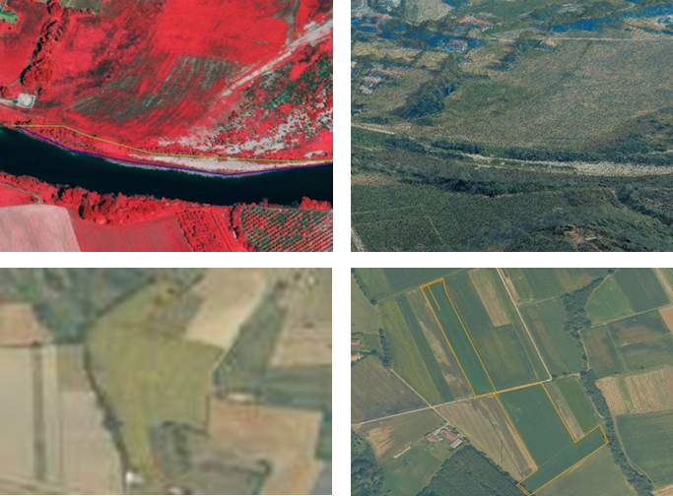



Success stories
Harvesting success: Piedmont’s digital agriculture breakthrough
Thanks to CHEDIH the SME achieved::
Results and benefits
Monitoring results integration
This allows the verification of land use on private lots prior to calibration on site, reducing the number of more costly on-site checks.
Positive impact on technologies
Land Parcel Identification System, Area Monitoring System and quality assessment are positively affected.
More precise metric measurements
Third vertical dimension, identification of water borders and results of checks are returned through a GIS layer indicating the outcome for each plot.
digital maturity boost:
ARPEA digital maturity was improved, but also it is now a potential channel for reaching out to farmers who are looking at ARPEA as an inspiration towards digitalistaion;
digitalisation for the territory:
the results are an incentive for farmers in the area to stick to the rules;
verification improvements:
quality of verifications is higher without relying on on-site visits for land use verification.
High-resolution mapping of remote parts of territory
Lessons learnt
Employ advisory teams to evaluate customer needs.
Use a predefined template to request a description of customer needs after the DMA.
Provide training and support to find investment services to the customer.

Slide 8

Good practices
A path to speed up digitalisation
EDIH
Challenges
Solutions
Services
SMEs, particularly in the construction and food industries, struggle to adopt advanced digital technologies like AI, cybersecurity, and IoT. These businesses often lack awareness of how these tools can address their specific operational needs. Additionally, they face barriers such as limited access to expert guidance, confusion about the potential benefits of digital transformation, and an overload of technical information that does not directly relate to their day-to-day activities.
Sector-specific workshops: I-NEST organised events tailored to different sectors focusing on digital technologies like AI, IoT, and cybersecurity.
Practical demonstrations: the events showcased real-world applications of these technologies, making it easier for SMEs to understand their relevance.
Collaboration with trusted intermediaries: by partnering with Chambers of Commerce, I-NEST ensured outreach and credibility with SMEs.
Simplified, accessible content: the content avoided technical jargon, focusing instead on actionable, easy-to-understand information that directly addressed SME needs.
Training and skills development, networking and access to innovation ecosystems
Technologies
AI and decision support, cybersecurity and internet of things (IoT)
Sectors
Travel and tourism, agricultural and food biotechnology, smart city, public administration, environment, food and beverages, healthcare, construction and assembly, cultural and creative economy, manufacturing and processing

Slide 9
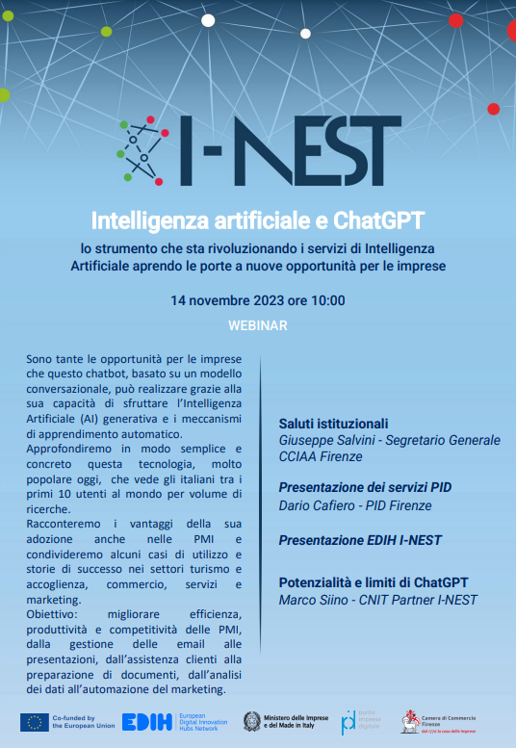


Good practices
A path to speed up digitalisation
Lessons Learnt
Results and benefits
High engagement
The events raised awareness of digitalisation opportunities among businesses, increasing their readiness to consider technology integration in their processes.
Positive impact
69% of participants reported feeling inspired by the presentations and saw clear potential in adopting digital technologies.
Importance of trusted networks: collaborating with intermediaries like Chambers of Commerce proved crucial for reaching the target audience effectively.
Keep it simple: avoiding overly technical jargon was key to keeping SMEs engaged, as too much complexity could deter interest or understanding.
Tailored approaches matter: customising digital solutions for specific industries made the events more relevant and actionable.
71% participation rate: demonstrates strong interest and relevance of digital transformation initiatives among SMEs;
19% feedback rate: indicates that almost one-fifth of participants provided feedback, helping organisers understand the impact and areas for improvement.
Image from I-NEST Webinar on AI and ChatGPT

