Slide 1
European Digital Innovation Hubs Network
Driving the EU’s digital transformation

Slide 2
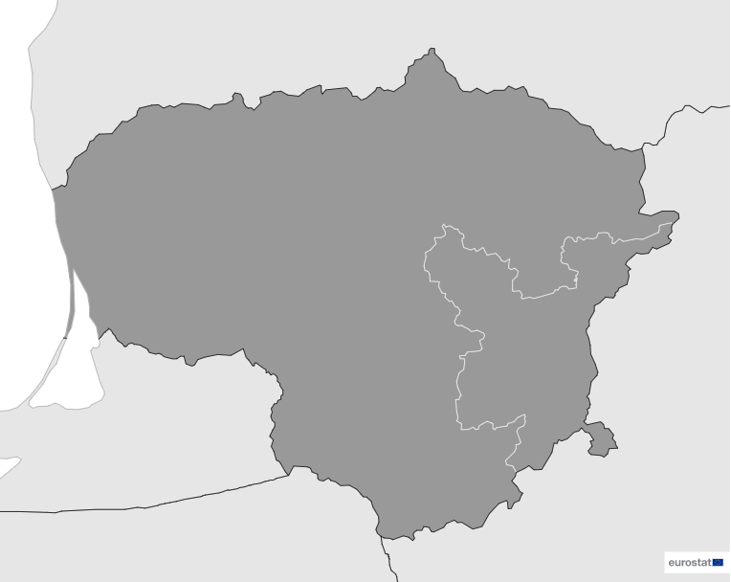

Lithuania
EDIH
SoE
3
Members
3/3 *EDIHs
10
Sectors
EDIHs in Lithuania
3
1
Prioritise promoting innovation in key sectors such as manufacturing, healthcare, and financial services, reflecting their commitment to advancing digital innovation, additionally contributing to areas like smart cities and energy, focusing on enhancing urban living and sustainability.
Actively support SMEs through initiatives in education and public administration, while also playing a pivotal role in advancing connectivity and technology within the telecommunications sector.
2
*European Digital Innovation Hubs
**Seal of Excellence
*Funded under Digital Europe Programme

Slide 3



Network overview: 3 members – 3 EDIHs
EDIH VILNIUS
DI4 LITHUANIAN ID
EDIH4IAE.LT

Slide 4
Driving the EU’s digital transformation
#EDIH_Network
7
Technologies
Services
Commit to cutting-edge digital solutions using a wide range of technologies, including AI and decision support, cyber-physical systems, cybersecurity, high-performance computing, digital twins, and the internet of things.
Prioritise the circular economy, SME support, technology transfer, and ecosystem building, underscoring their commitment to sustainability, SME growth, and fostering innovation ecosystems.
Place significant emphasis on artificial intelligence, cybersecurity, and cyber-physical systems, demonstrating their dedication to data-driven decision-making and security, with a strong focus on digital innovation.
Complement these services with innovation management, public sector innovation, and smart specialisation strategies.
Contribute to a comprehensive approach to digital transformation and innovation through high-performance computing, digital twins, and the internet of things.
european-digital-innovation-hubs.ec.europa.eu

Slide 5







Success stories
Using digital technologies to extend the lifespan of primary automotive products
Service type
Challenges
EDIH
Networking and access to innovation ecosystems,
support to find investment
Refurbishing and preparing used auto parts for reuse. Partnering with EDIH4IAE.LT, they developed a solution to analyse and predict refurbishment time and costs, ensuring traceability and efficient transmission to international sales.
CUSTOMER
GTV Projects
Specialised in pre-owned cars and cars components sales
Small-sized enterprise with 11-49 employees
Website.
Technologies
Solutions
AI and decision support
The company's digital transformation automated the analysis and forecasting of repair time and costs for auto parts, ensuring traceability and efficient transfer to international markets.
With EDIH4IAE.LT's expertise, AI was used to digitally transform production planning, warehouse management, sales, and logistics. Key features included sales statistics, eBay integration, connections to major sales platforms, mass uploads, price analysis, and an API interface.
Sectors
Automotive

Slide 6



Success stories
Using digital technologies to extend the lifespan of primary automotive products
Thanks to EDIH.LT the SME achieved::
Results and benefits
More efficient operation
Leveraging advanced technologies to streamline processes and reduce manual, repetitive tasks.
More sustainable products
Aligned with sustainability objectives by optimising resource use and reducing environmental impact, as well as aligning with the growing consumer demand for environmentally friendly options.
Perceived social/economic impact
Perceive a significant 20% expansion in production volumes. Moreover, this transformation led to a 35% increase in sales.
alternative financing:
the SME leveraged partial financial support through a development programme financed by the Ministry of Economy and Innovation;
increased sales:
sales increased 35% with a significant expansion of 20% in production volumes;
improved sustainability:
the resulting products are more environmentally sustainable.
Lessons learnt
EDIH4IAE.LT's expertise was essential for successful digital transformation.
Collaboration with partners led to a more comprehensive understanding of client needs.
Service quality improved due to a collaborative approach.

Slide 7

Good practices
Empowering manufacturing SMEs with cutting-edge digital skills
Challenges
Solution
EDIH
Manufacturing SMEs struggle to adopt digital technologies due to lack of understanding of how advanced digital tools like AI, digital twins, and blockchain can be applied to their specific business contexts. This knowledge gap is compounded by the absence of internal expertise, which prevents them from independently exploring and implementing these technologies. Additionally, SMEs often question the costs and benefits, making them hesitant to invest in digital transformation, fearing that the return on investment may not justify the effort and financial outlay.
Comprehensive digital skills training: delivered weekly, covering essential topics like AI, digital twins, blockchain, cybersecurity, and sustainability to build foundational knowledge.
Expert-led sessions: conducted by university professors to ensure high-quality, up-to-date instruction.
Practical, hands-on approach: training includes practical demonstrations, helping SMEs understand how to apply these technologies directly to their operations.
Post-training support: ongoing services are provided for SMEs that seek deeper engagement and further assistance in implementing digital solutions.
Services
Training and skills development
Technologies
AI and decision support, blockchain and distributed ledger technology, cybersecurity and digital twins
Sectors
Manufacturing and processing

Slide 8

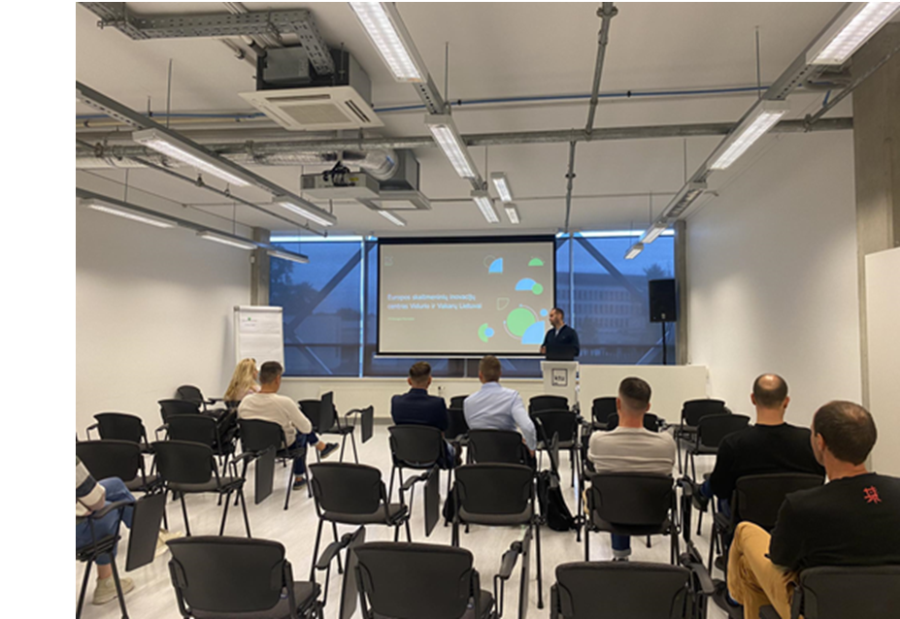
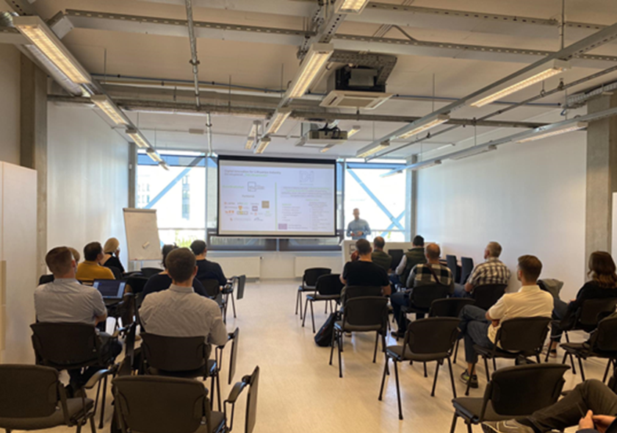

Good practices
Empowering manufacturing SMEs with cutting-edge digital skills
Lessons learnt
Results and benefits
Increased digital competence
18 participants from 11 different organisations successfully completed the programme, gaining valuable digital skills.
Sustained engagement
Out of the initial participants, five returned for additional services, indicating a high level of satisfaction and trust in the training.
Adoption of digital technologies
All 11 organisations expressed a commitment to implement digital technologies in their businesses after the training, highlighting the practical impact of the programme.
Adaptability of the training: the success of the programme was partly due to the adaptable nature of the content, which could be tailored to different company needs.
Importance of timing: offering the sessions at convenient times was essential to maximise participation.
Group size flexibility: adjusting the size of the training groups contributed to a more interactive and focused learning environment, enhancing participant engagement and retention of knowledge.
18 participants trained across 11 organisations
100% of organisations planned to implement digital technologies after completing the training, showing the direct influence of the programme on digital adoption.
Images from the DI4 Lithuanian training

