Slide 1
European Digital Innovation Hubs Network
Driving the EU’s digital transformation

Slide 2
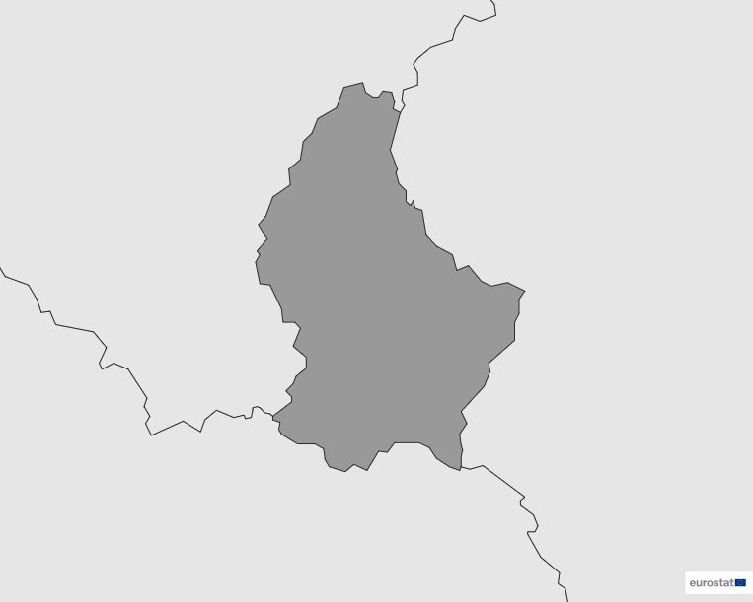
Luxembourg
EDIH
1
Member
1/1 *EDIH
1
Sector
EDIHs in Luxembourg
1
Contributes to the manufacturing and processing sector.
*European Digital Innovation Hubs
*Funded under Digital Europe Programme

Slide 3
Network overview: 1 member – 1 EDIH
L-DIH

Slide 4
Services
3 Technologies
Offers ecosystem building, field trials, finance, innovation management, SME support, and vocational training, highlighting their dedication to fostering innovation, business development, and skill enhancement within the ecosystem.
Covers a spectrum of key technologies, with special focus on high-performance computing and cybersecurity to make L-DIH a thriving agent on both areas.
Strong commitment to cutting-edge digital solutions based on artificial intelligence and decision support, while reinforcing cybersecurity measures.
Eighteen new digital transformation services carefully designed to integrate L-DIH in the country’s tech ecosystem and bridging it with EU-wide digital initiatives.
https://european-digital-innovation-hubs.ec.europa.eu/home

