Slide 1
European Digital Innovation Hubs Network
Driving the EU’s digital transformation

Slide 2
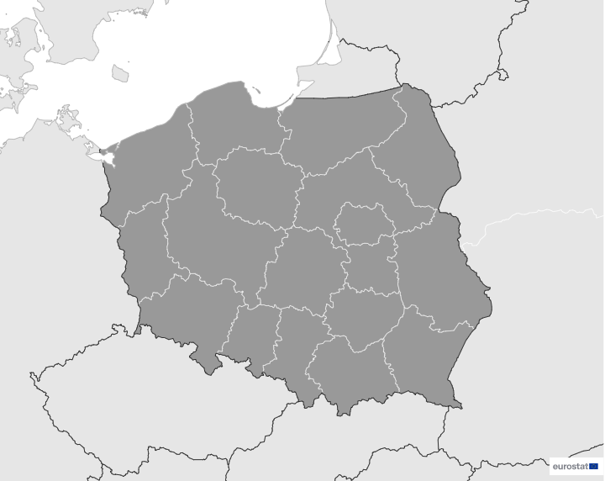
Poland
EDIH
SoE
1
14
Members
11/14 *EDIHs
3/14 **SoEs
3
4
8
2
35
Sectors
EDIHs in Poland
5
6
9
11
Engage actively in diverse sectors, including manufacturing, security, education, healthcare, and retail, reflecting a holistic approach to digital innovation.
Participate in sectors such as smart cities, transport and mobility, and environment, underscoring a commitment to addressing key societal issues through technology.
Operate in areas such as space, telecommunications, and financial services, demonstrating Poland's dedication to fostering innovation across multiple critical domains.
7
14
10
12
13
*European Digital Innovation Hubs
**Seal of Excellence (SoE)
*Funded under Digital Europe Programme

Slide 3
Network overview: 14 members – 11 EDIHs
CyberSec
EDIH-SILESIA
h4i
HPC4Poland EDIH
Mazovia EDIH
PDIH
re_d
Smart Secure Cities
TKDIH
WAMA EDIH
WRO4digITal

Slide 4
Network overview: 14 members – 3 SoEs
LUBDIGHUB
EDIH4CP-1
FTCH
LUBDIGHUB

Slide 5
Services
29 Technologies
Poland's EDIHs focus on a wide range of technologies, including micro- and nano-electronics, photonics, artificial intelligence, and cybersecurity, driving digital innovation and advanced manufacturing.
Poland's EDIHs provide a full range of services, including ecosystem building and SME support, to drive business growth and development.
With a strong emphasis on robotics, laser-based manufacturing, and simulation engineering, Poland's EDIHs are at the forefront of technological advancements in automation.
Emphasising knowledge transfer and prototyping, Poland's EDIHs facilitate the sharing of expertise and the development of new ideas.
Poland's EDIHs leverage big data, cloud services, internet of things, and virtual reality, showcasing their dedication to cutting-edge technologies and data-driven solutions.
With a strong commitment to technological innovation and technology transfer, Poland's EDIHs help bridge the gap between research and industry.
https://european-digital-innovation-hubs.ec.europa.eu/home

