Slide 1
European Digital Innovation Hubs Network
Driving the EU’s digital transformation

Slide 2
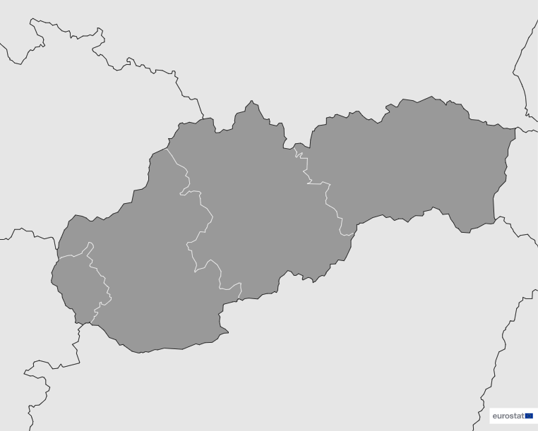
Slovakia
EDIH
SoE
5
Members
4/5 *EDIHs
1/5 **SoEs
29
Sectors
EDIHs in Slovakia
5
Focus on key sectors such as energy, transport and mobility, and telecommunications, highlighting efforts to enhance Slovakia's digital infrastructure and mobility solutions.
Commits to fostering innovation in areas such as education, aeronautics, and the cultural and creative economy, ensuring a comprehensive approach to digital growth.
1-3
Engage in a wide range of sectors, including manufacturing, smart cities, and public administration, driving digital innovation across traditional industries.
4
*European Digital Innovation Hubs
**Seal of Excellence (SoE)
*Funded under Digital Europe Programme

Slide 3
Network overview: 5 members – 4 EDIHs
CIH
EDCASS
EXPANDI 4.0
SKAI-eDIH

Slide 4
Network overview: 5 members – 1 SoE
SCDI proposal

Slide 5
Services
26 Technologies
Slovakian EDIHs prioritise advanced technologies like AI, cybersecurity, robotics, and big data to address complex challenges across various sectors.
Slovakian EDIHs offer key services in innovation management, technological innovation, and prototyping, driving digital growth and business development.
With a focus on cloud services, IoT, and software architectures, these EDIHs play a crucial role in facilitating digital innovation and transformation.
A strong emphasis on vocational training and knowledge transfer ensures the continuous development of skills and expertise across sectors.
Emphasising simulation engineering, laser-based manufacturing, and sensors and vision processing systems, Slovakian EDIHs are shaping the future of advanced manufacturing and digital simulation.
While services are robust, there is potential to enhance areas such as circular economy, public sector innovation, and financial support to further strengthen Slovakia's digital transformation ecosystem.
https://european-digital-innovation-hubs.ec.europa.eu/home

