Slide 1
European Digital Innovation Hubs Network
Driving the EU’s digital transformation

Slide 2
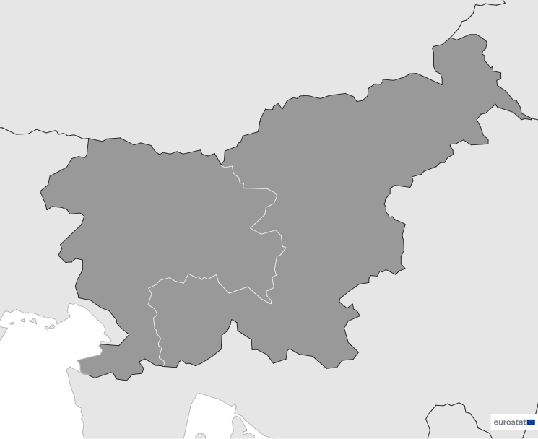

Slovenia
EDIH
SoE
3
Members
2/3 *EDIHs
2
1/3 **SoEs
12
Sectors
EDIHs in Slovenia
3
1
Slovenia's EDIHs support both traditional industries such as manufacturing and public administration, and innovative sectors including smart cities and telecommunications.
They focus on key sectors such as automotive, healthcare, and agricultural biotechnology, highlighting a balance between established industries and emerging technologies.
Additionally, an emphasis on education and community-led initiatives reflect Slovenia's commitment to nurturing human capital and empowering regional growth.
*European Digital Innovation Hubs
**Seal of Excellence (SoE)
*Funded under Digital Europe Programme

Slide 3

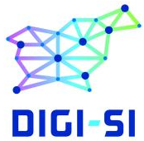
Network overview: 3 members – 2 EDIHs
DIGI-SI
SRC-EDIH

Slide 4
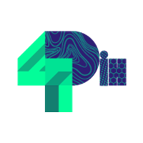
Network overview: 3 members – 1 SoE
4PDIH

Slide 5








Services
14 Technologies
Emphasise technologies including artificial intelligence, cybersecurity, and high-performance computing, driving innovation and solving complex challenges.
Focus on technology transfer, technological innovation, and vocational training to drive growth and skill development.
Focuses on blockchain, distributed ledger technology (DLT), internet of things, and virtual reality, positioning Slovenia at the cutting-edge of digital transformation.
Champion circular economy practices, promoting sustainable development across sectors.
Deploy advanced technologies strategically across various sectors, ensuring wide-reaching impact and innovation.
Provide dedicated support for public sector innovation, enhancing efficiency and fostering modernisation.
https://european-digital-innovation-hubs.ec.europa.eu/home

Slide 6




Good practices
Reviving the past: digital innovation in cultural heritage projects
EDIH
Challenges
Solution
Slovenia’s immovable cultural heritage, recorded in a register of over 30,000 entries, presented untapped potential for tourism. However, before the project, Slovenia lagged behind in digitalising cultural heritage, ranking 16th in Europe.
Additionally, tourism and cultural heritage sectors were disconnected, and advanced digital interpretation technologies were scarcely used in leading tourist destinations due to lack of knowledge, skills and funding.
In 2019, the Ministry set out to make Slovenia a leader in digitally enriched tourism experiences by merging cultural heritage with tourism development. The project focused on developing new tourism products inspired by cultural heritage, leveraging digital and hybrid interpretation methods. It also aimed to strengthen the competencies of tourism employees, raise the quality of tourist offerings, and foster local community pride through immersive, locally-rooted experiences.
This initiative has elevated Slovenia into the top 5 European countries for digital innovation in cultural heritage.
Services
Networking and access to innovation ecosystems and training and skills development.
Technologies
Virtual reality
Digital twins
Communication network
Sectors
Cultural and creative economy
Travel and tourism

Slide 7
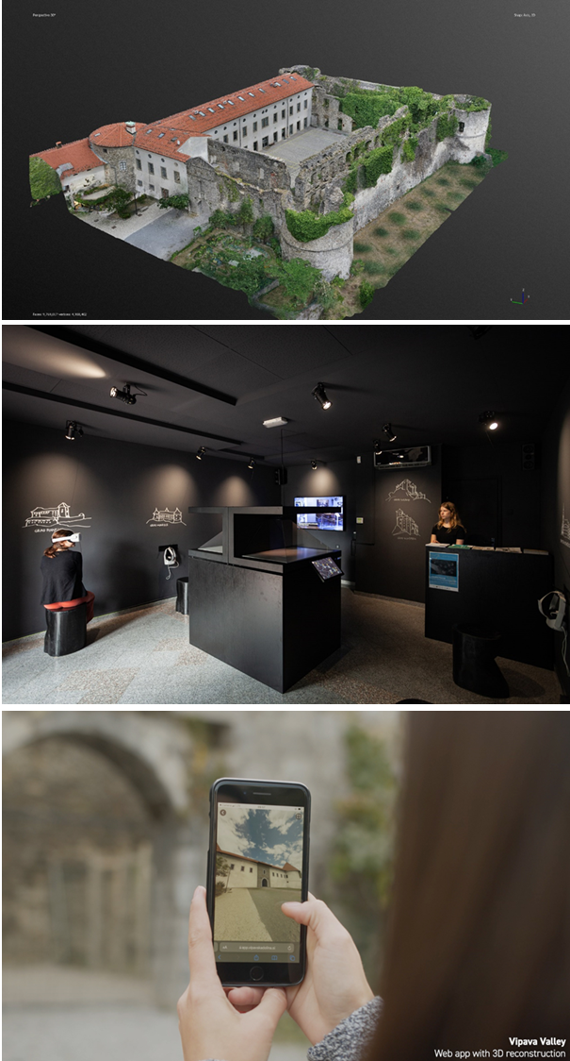



Good Practices
Reviving the Past: Digital Innovation in Cultural Heritage Projects
Results and Benefits
Lessons Learned
Embrace digital with purpose: digitalisation should enhance cultural heritage, not just exist for its own sake.
Value storytelling: stories connect tourists to heritage, making experiences more meaningful.
Focus on user experience: digital tools should be intuitive, engaging, and accessible.
Collaborate broadly: success comes from partnerships across communities, tourism, and heritage sectors.
Keep innovating: continuously explore new technologies to keep experiences fresh and relevant.
100 Digitised Cultural Heritage Units
Preserved valuable cultural assets, making them accessible and timeless.
30 Unique 5-Star Tourist Products
Developed immersive, locally-rooted experiences that have enhanced the tourism offering.
National and International Recognition
Elevated Slovenia’s profile as a leader in digital innovation in cultural heritage, highlighted by accolades and international showcases.
Slovenia’s innovative approach to digitising cultural heritage has not only preserved its history but also redefined its tourism landscape!
Innovative Digital Approaches to Cultural Heritage in Slovenia

Slide 8


Success stories
Green Point's Digital Leap in Sustainable Farming
Service type
Challenges
EDIH
Test before invest
Ensuring transparency, traceability, and trust in a complex short food supply chain involving over 70 local farmers and producers, while overcoming technological barriers and resistance to change.
CUSTOMER
Zelena točka trans z.o.o.
Website
Micro-sized enterprise with 1-9 employees.
Technologies
Blockchain and distributed ledger technology (DLT)
Solutions
Blockchain implementation: created a decentralised, immutable record of product journeys, enhancing transparency and trust;
Collaboration with DIH Agrifood and Blockchain Lab: strengthened technological integration and innovation;
Support for local farmers: empowered sustainable, community-driven food practices by bridging the gap between producers and consumers.
Sectors
Agricultural biotechnology and food biotechnology

Slide 9
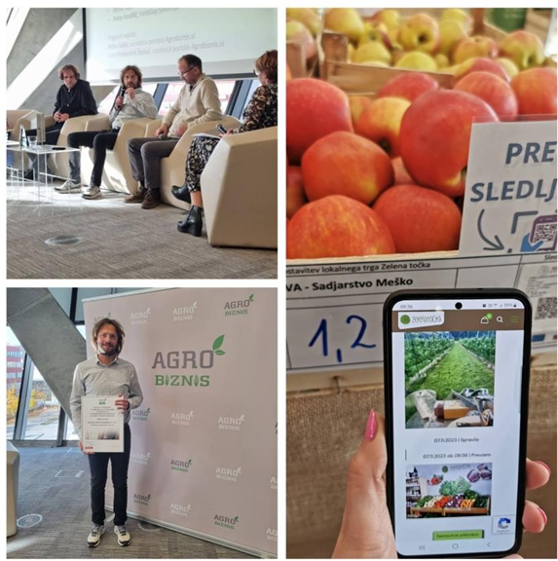


Success stories
Green Point's Digital Leap in Sustainable Farming
Thanks to EDIH DIGI-SI the SME achieved::
Results and benefits
Blockchain integration
Efficient data management, accurate traceability, and increased trust in local food provide significant benefits to stakeholders.
Access to living labs
The collaborative testing environment accelerated innovation and scalability.
transparency and trust:
Blockchain enabled precise tracking from farm to table, ensuring authenticity and fostering consumer trust;
improved traceability:
facilitated accurate identification of farm origins for each product, which was previously unattainable;
direct connection with local producers:
strengthened relationships between consumers and local farms, supporting sustainable agriculture.
Leading the Way in Agri-Food Innovation with Blockchain Technology
Lessons learnt
Effective technology integration: streamlined processes enhanced transparency.
Challenges: initial hurdles emerged in onboarding farms.
Key improvements: integration processes must be simplified to bolster stakeholder education on blockchain benefits.
Strategic identification and integration of specialised partners (AI solution provider, marketing experts, 3D printing specialist) with industry-specific expertise.
Optimisation of the synergy between digital and traditional marketing

